Slide 1
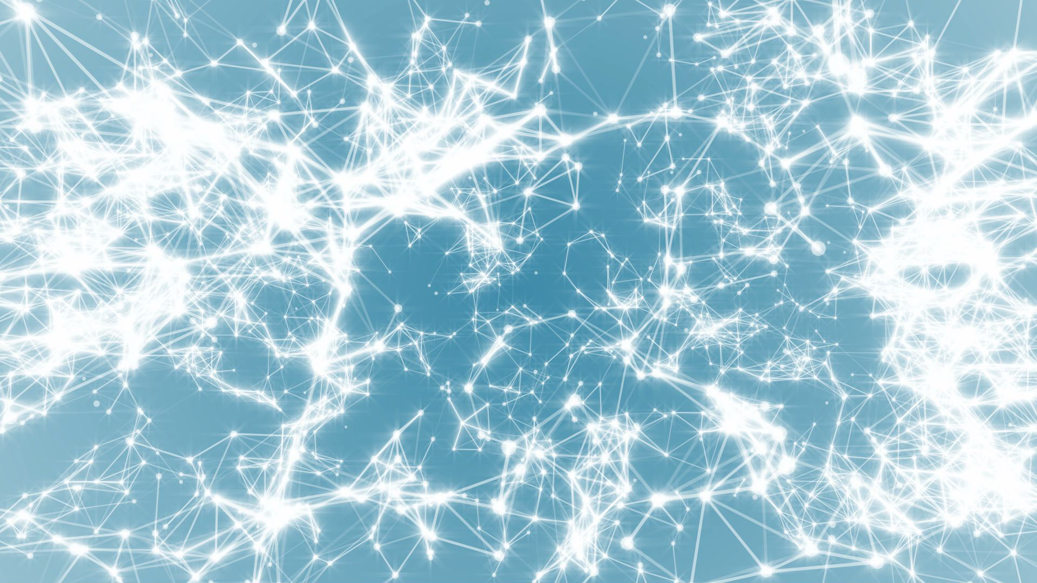
Network Science
Class 1: Introduction
(Ch1 in Textbook)
Albert-László Barabási
with
Roberta Sinatra
www.BarabasiLab.com

Slide 2
Section 2: FROM SADDAM HUSSEIN TO NETWORK THEORY
FROM SADDAM HUSSEIN TO NETWORK THEORY
Network Science: Introduction

Slide 3


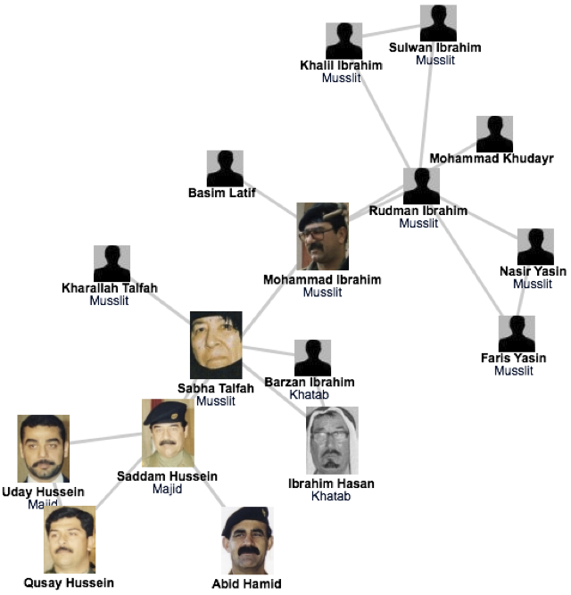
A SIMPLE STORY (1) The fate of Saddam and network science
Network Science: Introduction
Network Science: Introduction
Notes:
Invasion that started in March 19, 2003. Many of the regime's high ranking officials, including Saddam Hussein, avoided capture.
Hussein was last spotted kissing a baby in Baghdad in April 2003, and then his trace went cold.
designed a deck of cards, each card engraved with the images of the 55 most wanted.
It worked: by May 1, 2003, 15 men on the cards were captured, and by the end of the month another 12 were under custody.
Yet, the ace of spades (see Figure), i.e. Hussein himself, remained at large.
Col James Hickey, in charge of a series of raids known Operation Desert Scorpion, wanted to know the relationship between everyone killed or captured. The task fell to Lt. Col. Steve Russell, who was in direct charge of the raids. Then there was Brian Reed, the operations officer under Col. Hickey, who was exposed to social networks during his studies at West Point.
Realizing that capturing the faces of the Iraq regime was of little help in cornering Saddam himself, these men started to systematically reconstruct the social network of Saddam's inner circle. They did not rely on government documents and decrees, but rather gossip and family trees. Instead of focusing on military titles, they learned to understand the five names each Iraqi man had, listing the name of their father, grandfather, and the city of origin-- serving as a family tree.
As they meticulously pieced together an extensive diagram of who drank with whom and who is related to whom in the Tikrit region, where Saddam was from, they started to use network diagrams to guide the raids. In one of those raids they found over \$8 million in US currency, about \$1 million in Iraqi currency, jewelry worth over \$2 million, rifles and ammunition. Yet, the biggest prize was Saddam's family photo album, providing the faces of those that the family trusted, filling with intimate details their growing network diagram.
Their increasingly detailed maps consistently pointed to two individuals, Rudman Ibrahim and Mohammed Ibrahim. They served instead as Saddam's second-level bodyguards, numbering about 40 who ran the daily tasks, serving as his driver, cook, or mechanic.
Yet, Rudman, whom the investigators believed that he knew Hussein's whereabouts, had a heart attack and died within a few hours of his capture.
Next the investigators used their network diagram to identify individuals who could have known the whereabouts of Mohammad, dubbed the "fat man". Not a major player in the regime's power structure, while Saddam's whereabouts kept secret, Mohammed's social ties were not as protected as Saddam's.
once they found someone to turned Mohammed Ibrahim in, the same man escorted them to a farm near the Tigris river, reveling the spider hole that hid the dictator himself.

Slide 4
Thex
A SIMPLE STORY (1) The fate of Saddam and network science
The capture of Saddam Hussein:
shows the strong predictive power of networks.
underlies the need to obtain accurate maps of the networks we aim to study; and the often heroic difficulties we encounter during the mapping process.
demonstrates the remarkable stability of these networks: The capture of Hussein was not based on fresh intelligence, but rather on his pre-invasion social links, unearthed from old photos stacked in his family album.
shows that the choice of network we focus on makes a huge difference: the hierarchical tree, that captured the official organization of the Iraqi government, was of no use when it came to Saddam Hussein's whereabouts.
Network Science: Introduction
Network Science: Introduction

Slide 5
Section 3 VULNERABILITY DUE TO INTERCONNECTIVITY
VULNERABILITY DUE TO INTERCONNECTIVITY
Network Science: Introduction

Slide 6
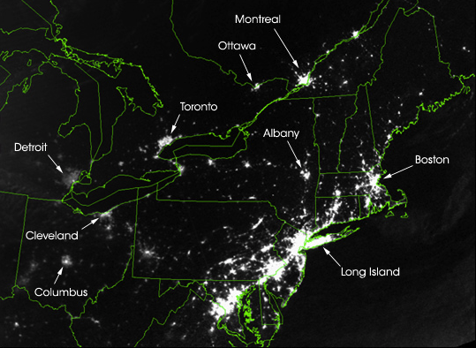
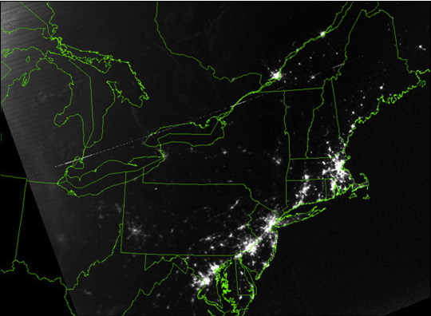
Thex
A SIMPLE STORY (2): August 15, 2003 blackout.
August 14, 2003: 9:29pm EDT
20 hours before
August 15, 2003: 9:14pm EDT
7 hours after
Network Science: Introduction
Network Science: Introduction
Notes:
At a first look the two satellite maps of Image 1.3a/b are indistinguishable: lights shining brightly in highly populated areas, and dark spaces marking vast uninhabited forests and oceans. Yet, upon closer inspection something strange becomes apparent. The light in several regions, Toronto, Detroit, Cleveland, Columbus, Long Island have simply disappeared. This is not a doctored shot from the next Armageddon movie but represents a real image of the US Northeast on August 14, 2003, the night of a blackout that left an estimated 45 million people in eight US states and another 10 million in Ontario without power. It illustrates a much ignored aspect of networks, one that will be an important theme in this book: vulnerability due to interconnectivity.
The 2003 blackout is a typical example of a cascading failure. When a network acts as a transportation system, a lo- cal failure shifts loads to other nodes. If the extra load is negligible, the rest of the system can seamlessly absorb it, and the failure remains effectively unnoticed. If the extra load is too much for the neighboring nodes to carry, they will either tip or redistribute the load to their neighbors. Either way, we are faced with a cascading failure, the magnitude of which depends on the network position and capacity of the nodes that have been removed in the first and subsequent rounds. Case in point is electricity: as it cannot be stored, when a line goes down, its power must be shifted to other lines. Most of the time, the neighboring lines have no difficulty carrying the extra load. If they do, they will also tip and redistribute their increased load to their neighbors.
Cascading failures can occur in most complex systems. They take place on the Internet, when traffic is rerouted to bypass malfunctioning routers, occasionally creating denial of service attacks on routers that do not have the capacity to handle extra traffic. We witnessed one in 1997, when the International Monetary Fund pressured the central banks of several Pacific nations to limit their credit. There was a cascading failure behind the 2009-2011 financial melt- down, when the US credit crisis paralyzed the economy of the globe, leaving behind scores of failed banks, corporations, and even bankrupt states. Cascading failures are occasionally our ally, however. The world wide effort to dry up the money supply of terrorist organizations is aimed at crippling terrorist networks, and doctors and researchers hope to induce cascading failures to kill cancer cells.
The Northeast blackout illustrates an important theme of this book: we must understand how the network structure affects the robustness of a complex system. We will there- fore develop quantitative tools to assess the interplay between network structure and dynamical processes on net- works and their impact on failures. Although such failures may appear chaotic and unpredictable, we will learn that they follow rather reproducible laws that can be quantified and even predicted using the tools of network science.

Slide 7
Thex
A SIMPLE STORY (2): August 15, 2003 blackout.
An important theme of this class:
we must understand how network structure affects the robustness of a complex system.
develop quantitative tools to assess the interplay between network structure and the dynamical processes on the networks, and their impact on failures.
We will learn that failures reality failures follow reproducible laws, that can be quantified and even predicted using the tools of network science.
Network Science: Introduction
Network Science: Introduction
Notes:
The Northeast blackout illustrates an important theme of this class: we must understand how network structure affects the robustness of a complex system. We will therefore develop the quantitative tools to assess the interplay between network structure and the dynamical processes on the networks, and their impact on failures. As chaotic as such a failure may seem, we will learn that in reality it follows rather reproducible laws, that can be quantified and even predicted using the tools of network science.
http://colli239.fts.educ.msu.edu/2003/08/15/us-and-canadian-cities-left-in-dark-august-2009/

Slide 8
Section 4 NETWORKS AT THE HEART OF COMPLEX SYSTEMS
NETWORKS AT THE HEART OF COMPLEX SYSTEMS
Network Science: Introduction

Slide 9
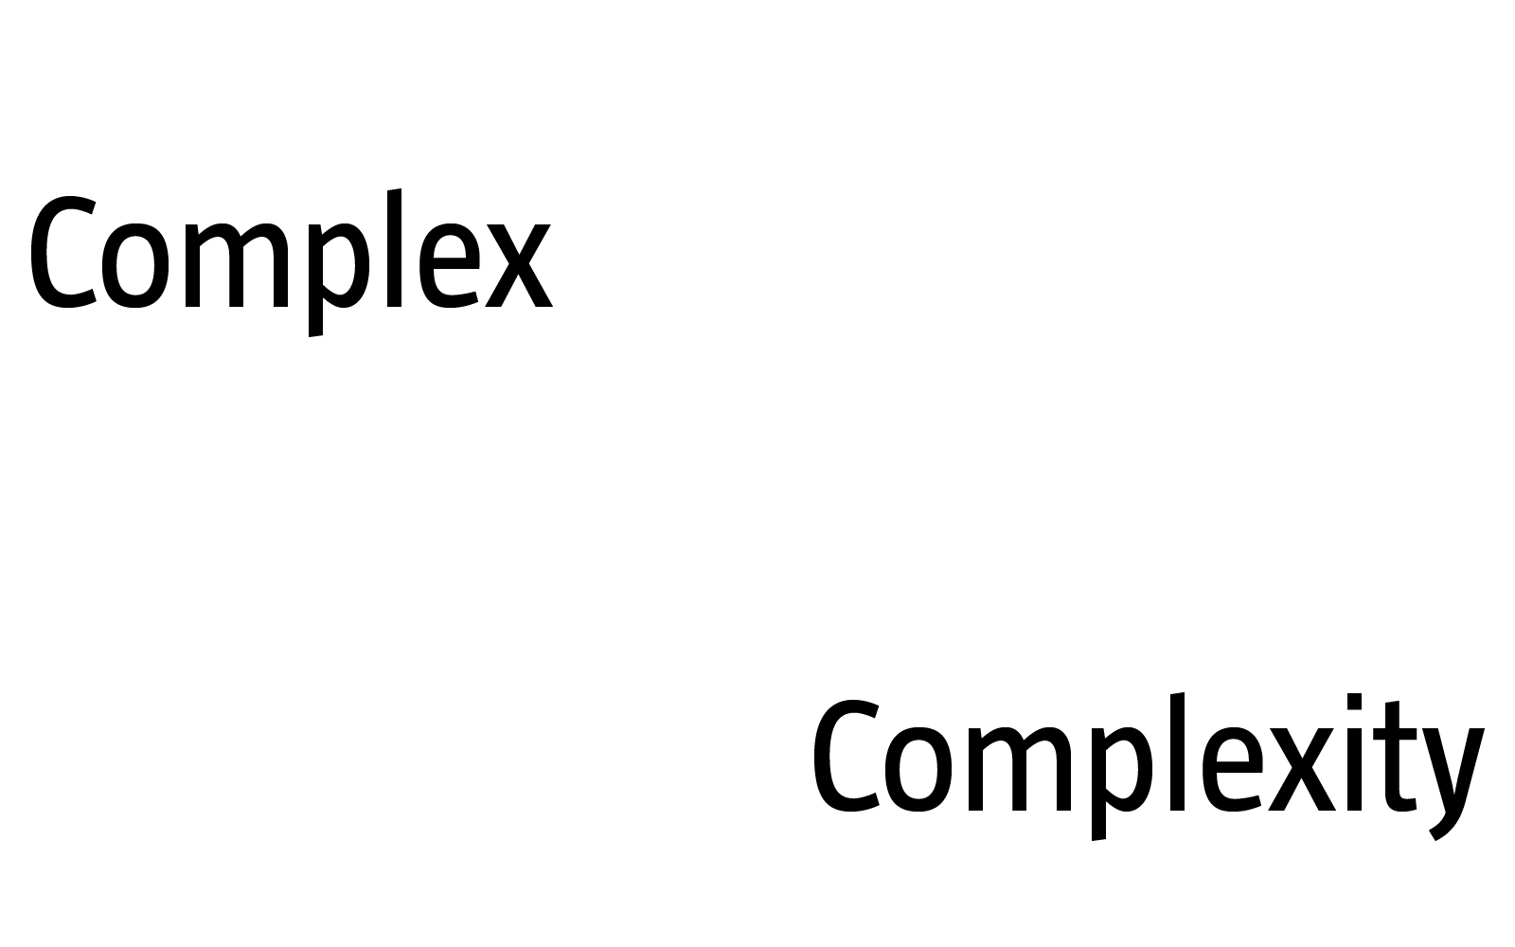
COMPLEX SYSTEMS
Complexity, a scientific theory which asserts that some systems display behavioral phenomena that are completely inexplicable by any conventional analysis of the systems’ constituent parts. These phenomena, commonly referred to as emergent behaviour, seem to occur in many complex systems involving living organisms, such as a stock market or the human brain.
Source: John L. Casti, Encyclopædia Britannica
[adj., v. kuh m-pleks, kom-pleks; n. kom-pleks]
–adjective
1.
composed of many interconnected parts; compound; composite: a complex highway system.
2.
characterized by a very complicated or involved arrangement of parts, units, etc.: complex machinery.
3.
so complicated or intricate as to be hard to understand or deal with: a complex problem.
Source: Dictionary.com
Network Science: Introduction
Notes:
We are surrounded by systems that are hopelessly complicated, from the society, whose seamless functioning requires cooperation between billions of individuals, to communications infrastructures that integrate billions of cell phones with computers and satellites. Our ability to reason and comprehend the world around us is guaranteed by the coherent activity of billions of neurons in our brain. Our very existence is rooted in seamless interactions between thousands of genes and metabolites with- in our cells. These systems are collectively called complex systems. Given the important role they play in our life, in science and economy, the understanding, mathematical description, prediction, and eventually the control of such complex systems is one of the major intellectual and scientific challenges of the 21st century.
The emergence of network theory, at the dawn of the 21st century is a vivid demonstration that science can live up to this challenge. Indeed, behind each complex system, there is an intricate network that encodes the interactions between the system’s components:

Slide 10
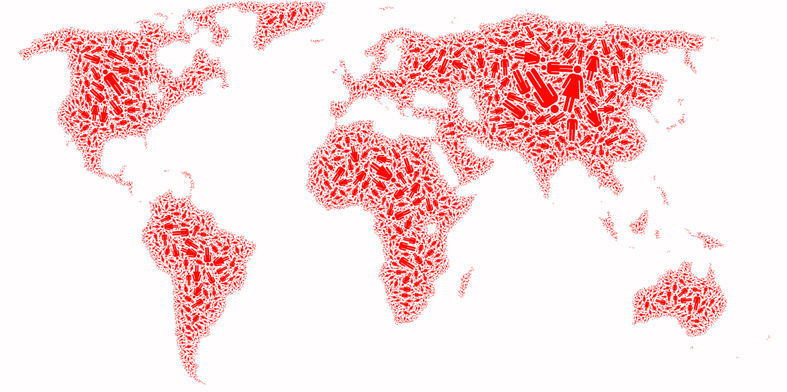
SOCIETY Factoid:
The "Day of 7 Billion" has been targeted by the United States Census Bureau to be in July 2012.
http://en.wikipedia.org/wiki/World_population
Network Science: Introduction
Notes:
The sum of all professional, friendship, and family ties is the fabric of the society.

Slide 11
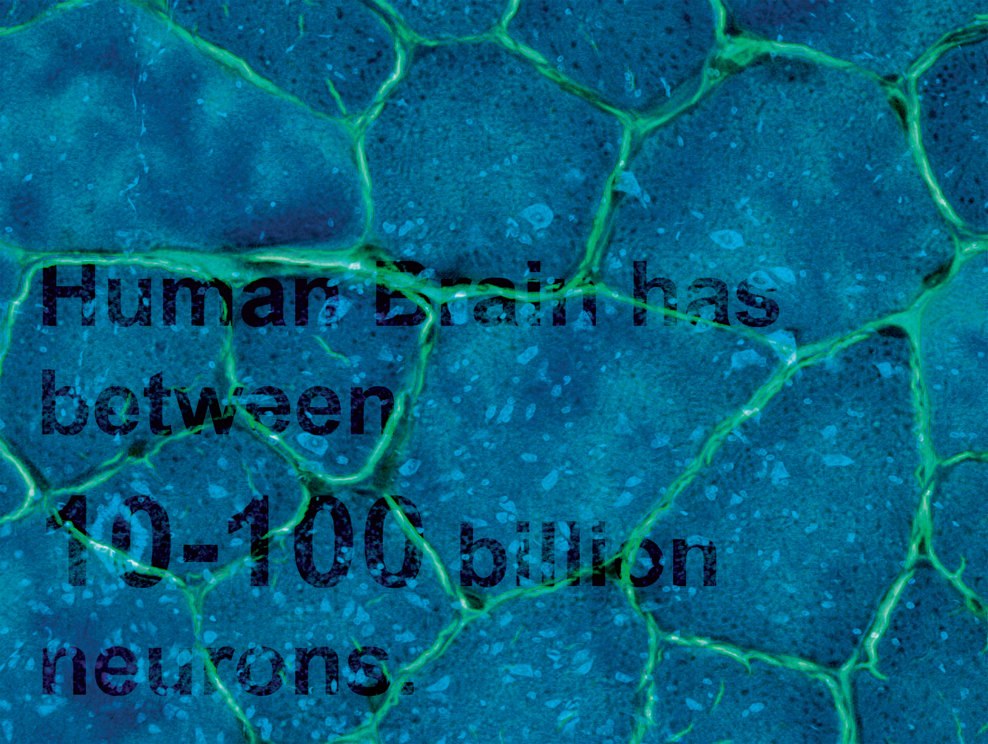
Brain
BRAIN Factoid:
Factoid:
Human Brain has between
10-100 billion neurons.
Network Science: Introduction
Notes:
The wiring diagram capturing the connections between neural cells holds the key to our understanding of brain functions.

Slide 12

ECONOMY Factoid:
The world economy produced goods and services worth almost $55 trillion in 2005.
(http://siteresources.worldbank.org/ICPINT/Resources/ICPreportprelim.pdf)
Network Science: Introduction

Slide 13
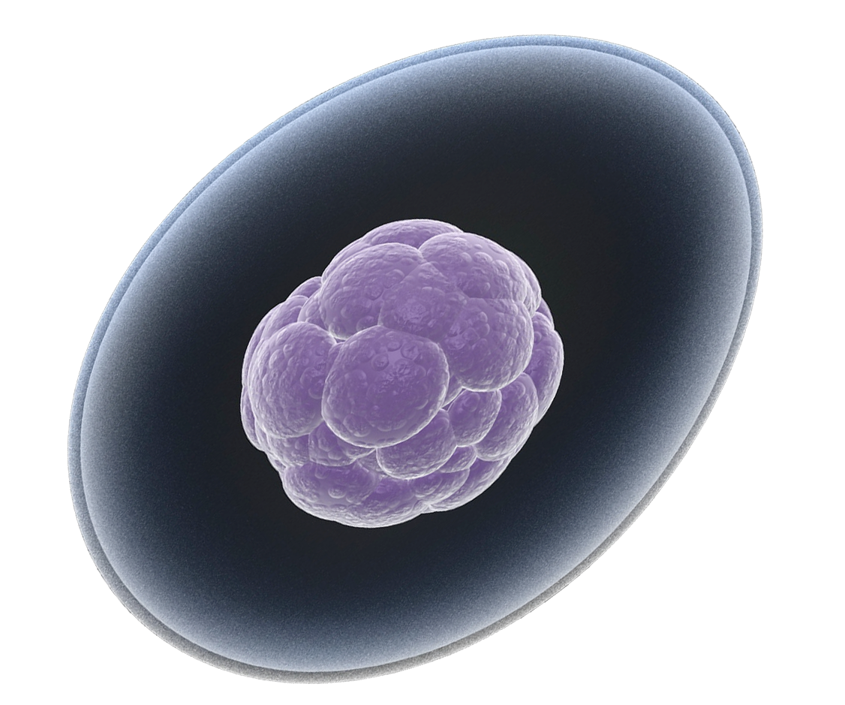
THE HUMAN CELL Factoid:
How Many Genes are in
the Human Genome?
http://www.ornl.gov/sci/techresources/Human_Genome/faq/genenumber.shtml
23,299
Network Science: Introduction
Notes:
The network describing the interactions between genes, proteins, and metabolites integrates the processes behind living cells.

Slide 14
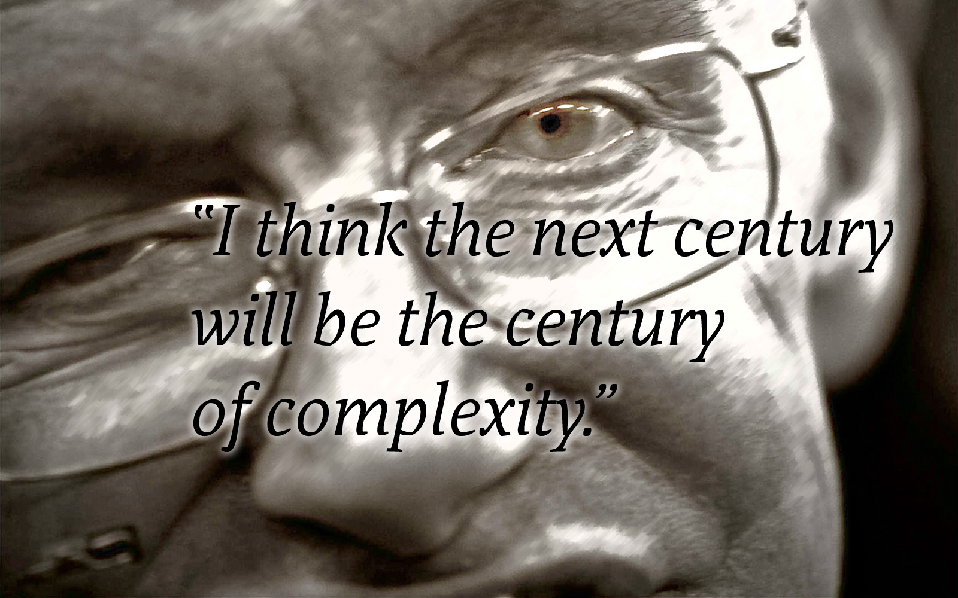
Stephen Hawking
January 23, 2000`
Network Science: Introduction

Slide 15
THE ROLE OF NETWORKS
Behind each complex system there is a network, that defines the interactions between the component.
Network Science: Introduction

Slide 16
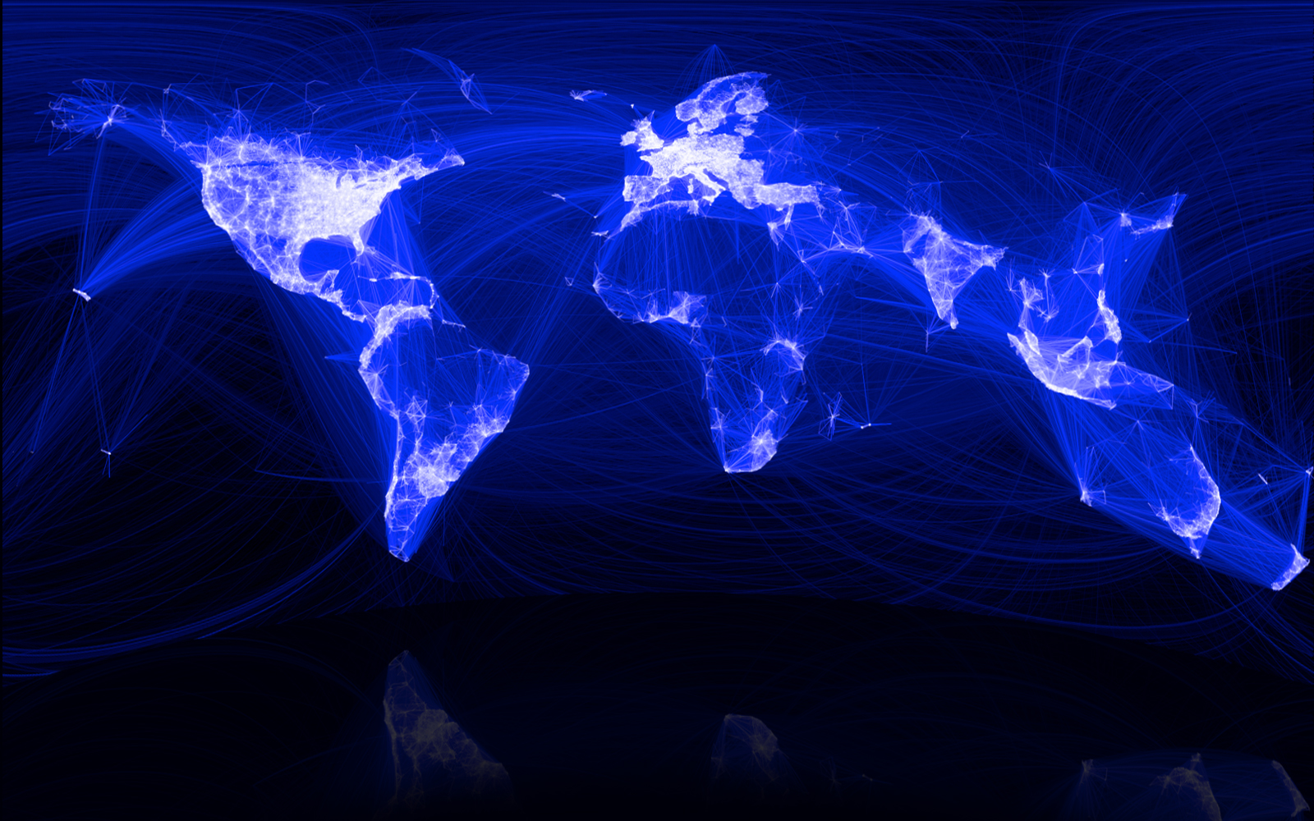
SOCIETY Factoid:
The “Social Graph” behind Facebook
Keith Shepherd's "Sunday Best”. http://baseballart.com/2010/07/shades-of-greatness-a-story-that-needed-to-be-told/
Network Science: Introduction
Notes:
The network describing the interactions between genes, proteins, and metabolites integrate the processes behind living streams. The wiring diagram capturing the connections between neural cells hold the key to our understanding of brain functions. The sum of all professional, friendship, and family ties is the fabric of the society. The network describing which communication devices interact with each other, capturing internet connections to wireless links, is the heart of the modern communication system. The power grid, a network of generators and transmission lines, supplies with energy virtually all modern technology. Trade networks maintain our ability to exchange goods and services, being responsible for the material prosperity that an increasing fraction of the world has enjoyed since WWII (Image 2). They also play a key role in the spread of financial and economics crises. Networks are at the heart of some of the most revolutionary technologies of the 21st century, empowering everything from Google to Facebook, CISCO, and Twitter. At the end, networks permeate science, technology, and nature to a much higher degree than may be evident upon a casual inspection. Consequently, we will never understand complex systems unless we gain a deep understanding of the networks behind them.While network science is a relatively young field, its roots go back several centuries. The scientific explosion of the field has experienced during the first decade of the 21st century is rooted in the discovery that despite the apparent differences, the emergence and evolution of rather different networks is driven by a common set of fundamental laws and reproducible mechanism. Hence despite amazing the diversity in form, size, nature, age, and scope present in real networks, most networks observed in nature, society, and technology are driven by common organizing principles. In other words once we disregard the nature of the components and their interactions, the obtained networks appear to be more similar than different from each other. In the following sections we discuss the forces that have led to the emergence of this new research field and its impact on science, technology, and society.

Slide 17
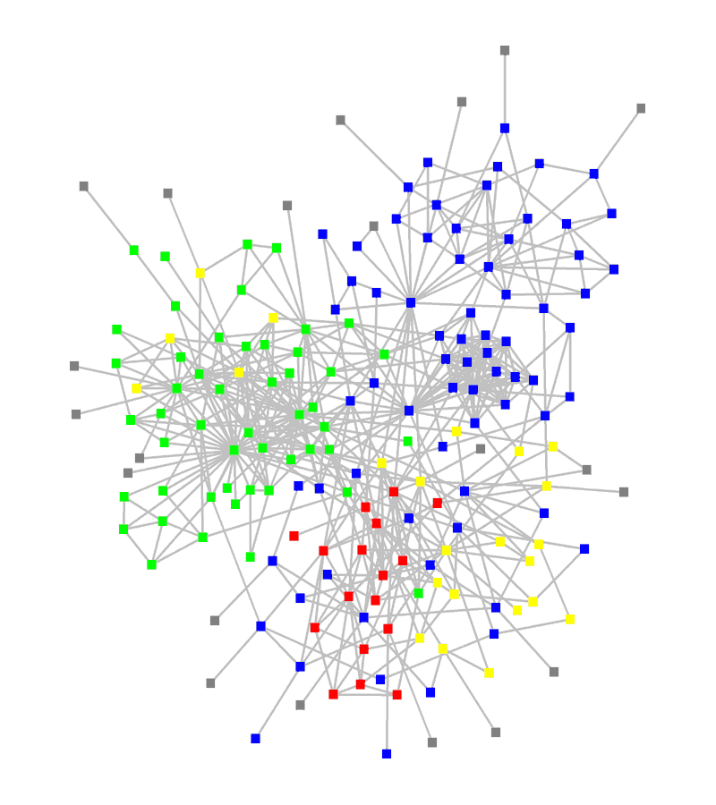
STRUCTURE OF AN ORGANIZATION
: departments
: consultants
: external experts
www.orgnet.com
Network Science: Introduction

Slide 18
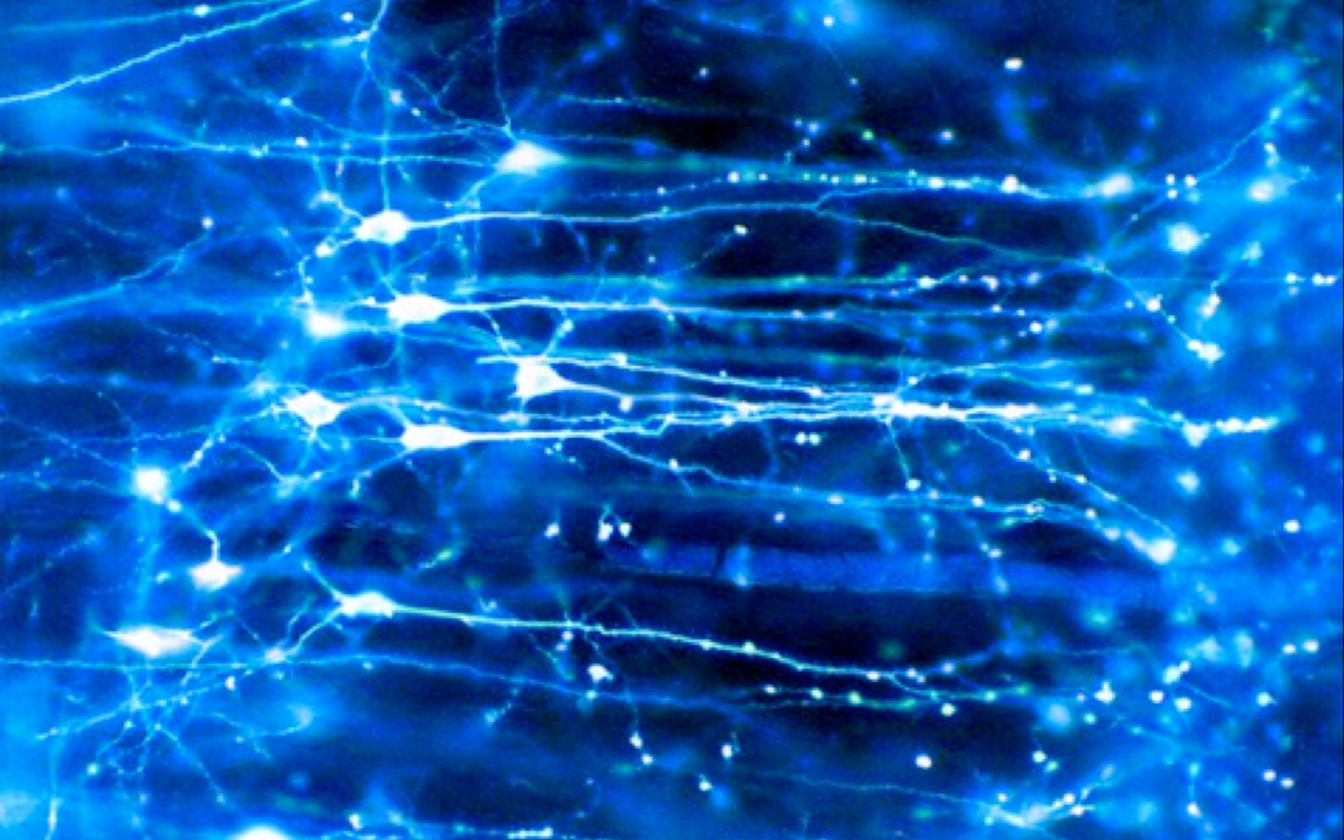
Brain
BRAIN Factoid:
Human Brain has between
10-100 billion neurons.
Network Science: Introduction
Notes:
We are surrounded by systems that are hopelessly complex, from the society, a collection of six billion individuals, to communications systems, that these days link billions of devices, from computers to cell phones. Our very existence is rooted in the ability of thousands of genes to work together in a seamless fashion; our thoughts, reasoning, and comprehension of the world is hidden in the connections between billions of neurons in our brain. These systems, random looking at first, upon close inspection display endless signatures of order and self-organization whose quantification, understanding, prediction and eventually control is the major intellectual challenge for the science of the 21st century

Slide 19

The subtle financial networks
Network Science: Introduction
Notes:
{\bf The subtle networks behind the economy.}
A credit card, selected as the 99th object in the popular exhibition by the British Museum, entitled {\it The History of the World in 100 Objects.} This card demonstrates the interconnected nature of the modern economy, creating subtle linkages that one normally does not even think of. The card was issued in the United Arab Emirates in 2009 by the Hong Kong and Shanghai Banking Corporation, commonly known HSBC, a London based bank. The card functions through protocols provided by VISA, an USA based credit association. Yet, the card adheres to Islamic banking principles, which operates in accordance with Fiqhal-Muamalat (Islamic rules of transactions), most notably the elimination of interest or {\it riba}. The card is not limited to Muslims in the United Arab Emirates, but it is also offered to Muslim minorities in non-Muslim countries, and it is also used by many non-Muslims who agree with its strict ethical guidelines

Slide 20
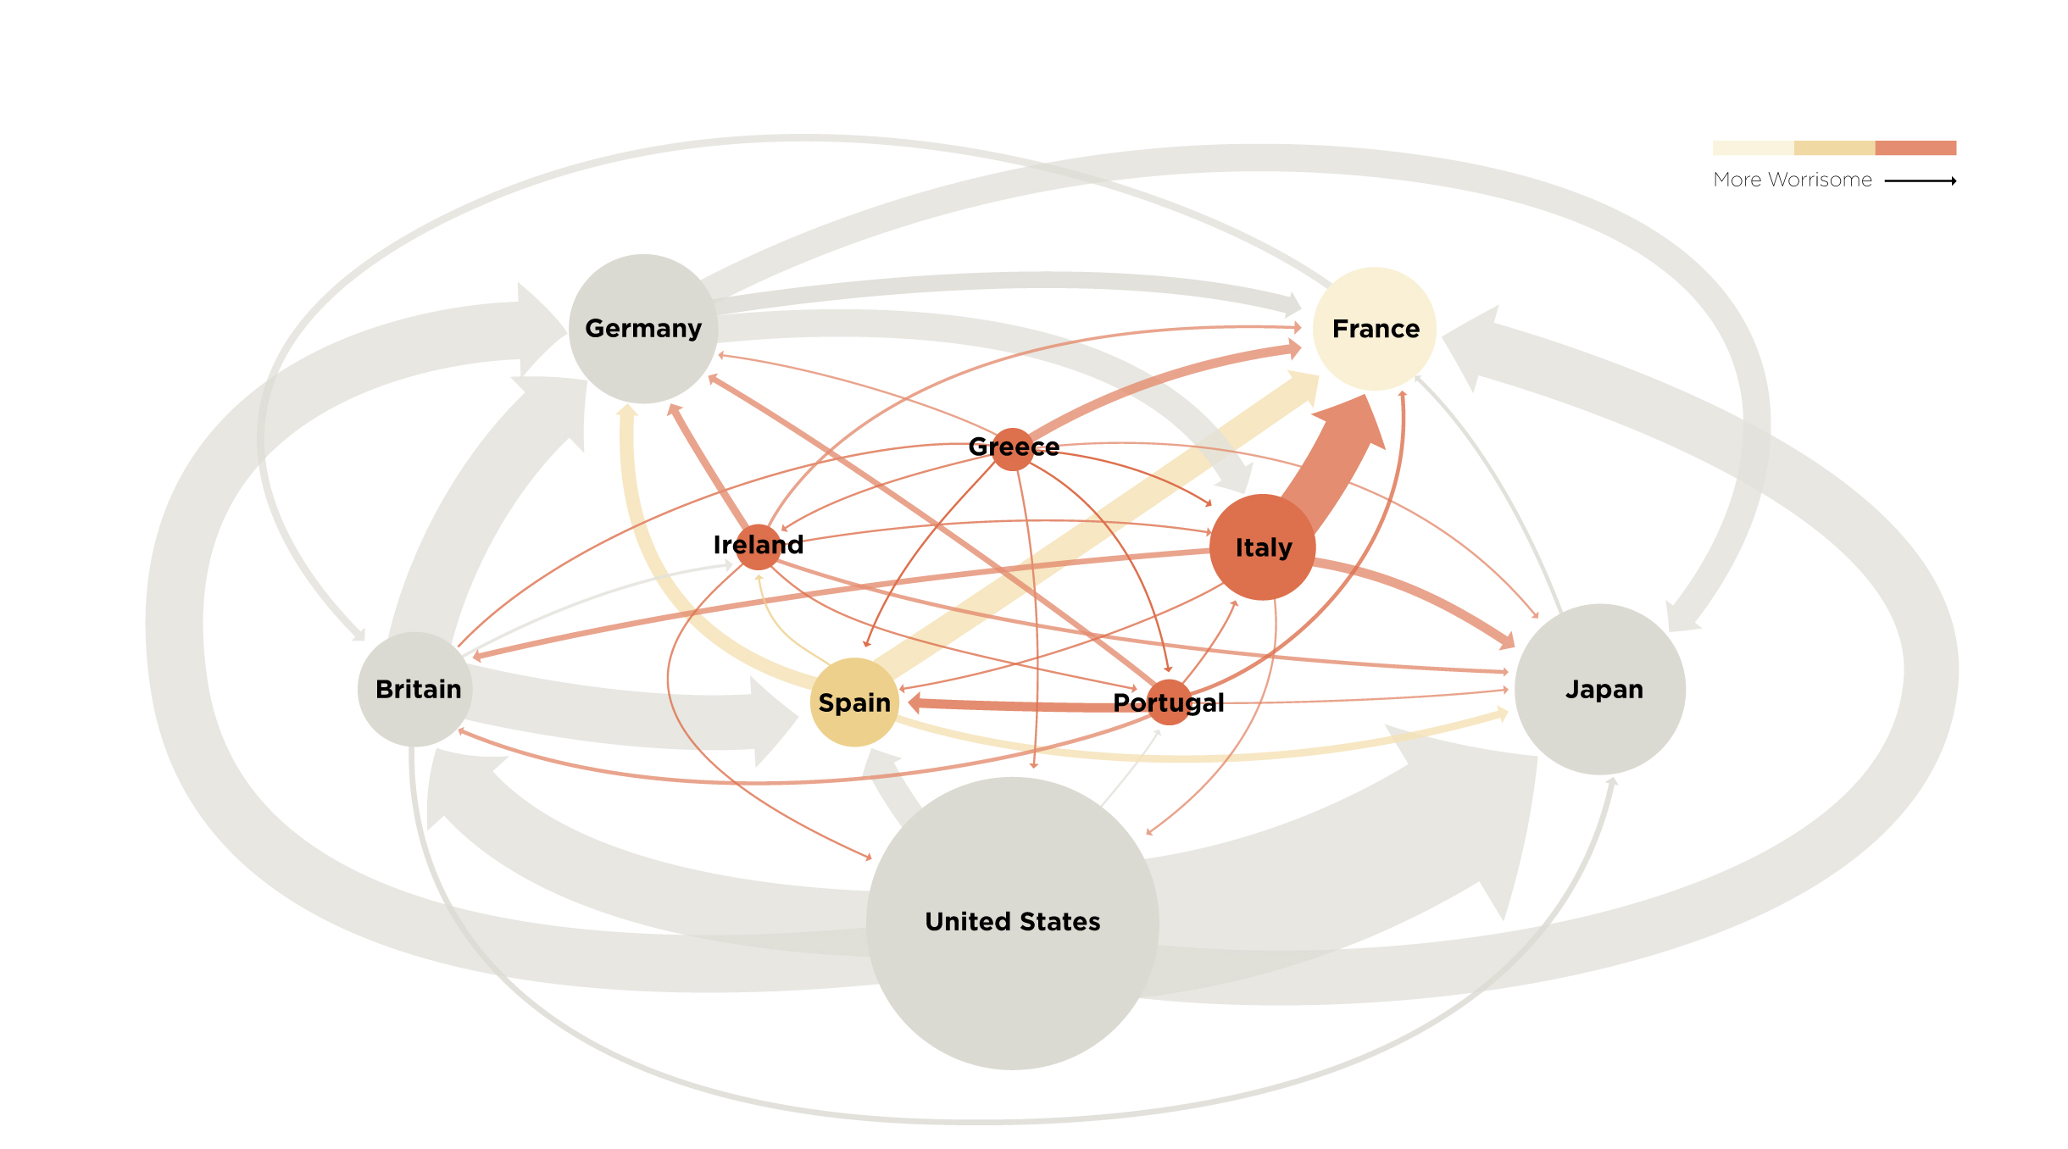
The not so subtle financial networks: 2011
Network Science: Introduction
Notes:
{\bf The subtle networks behind the economy.}

Slide 21
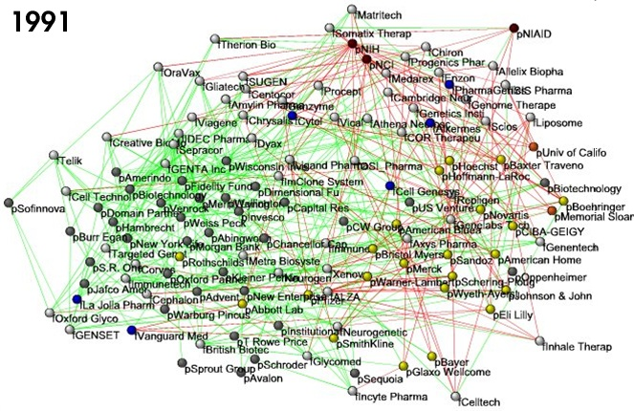
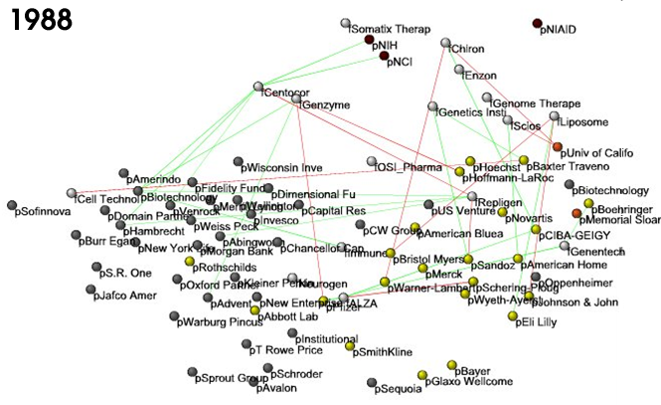
BUSINESS TIES IN US BIOTECH-INDUSTRY
Nodes:
Companies
Investment
Pharma
Research Labs
Public
Biotechnology
Links:
Collaborations
Financial
R&D
http://ecclectic.ss.uci.edu/~drwhite/Movie
Network Science: Introduction

Slide 22
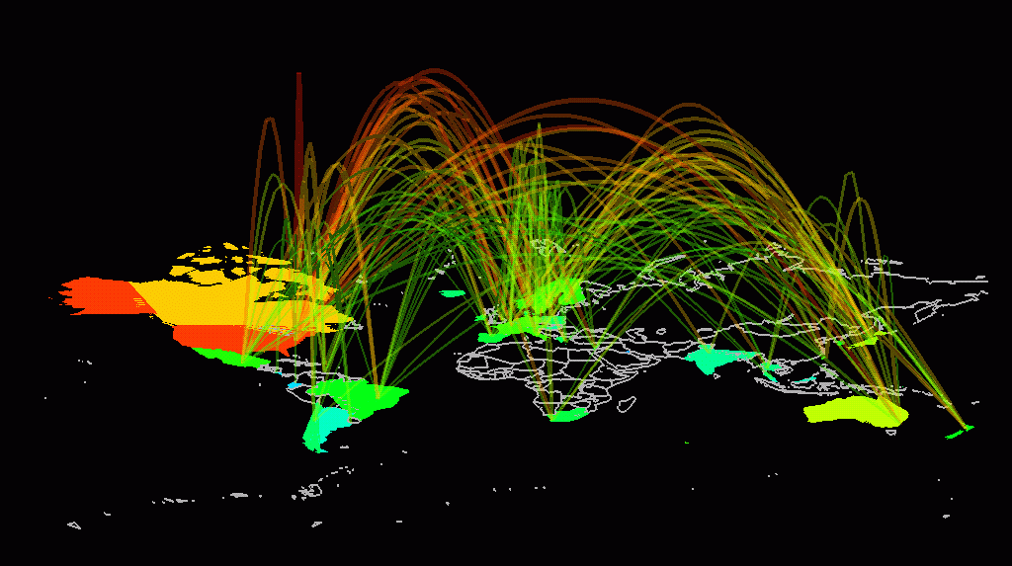
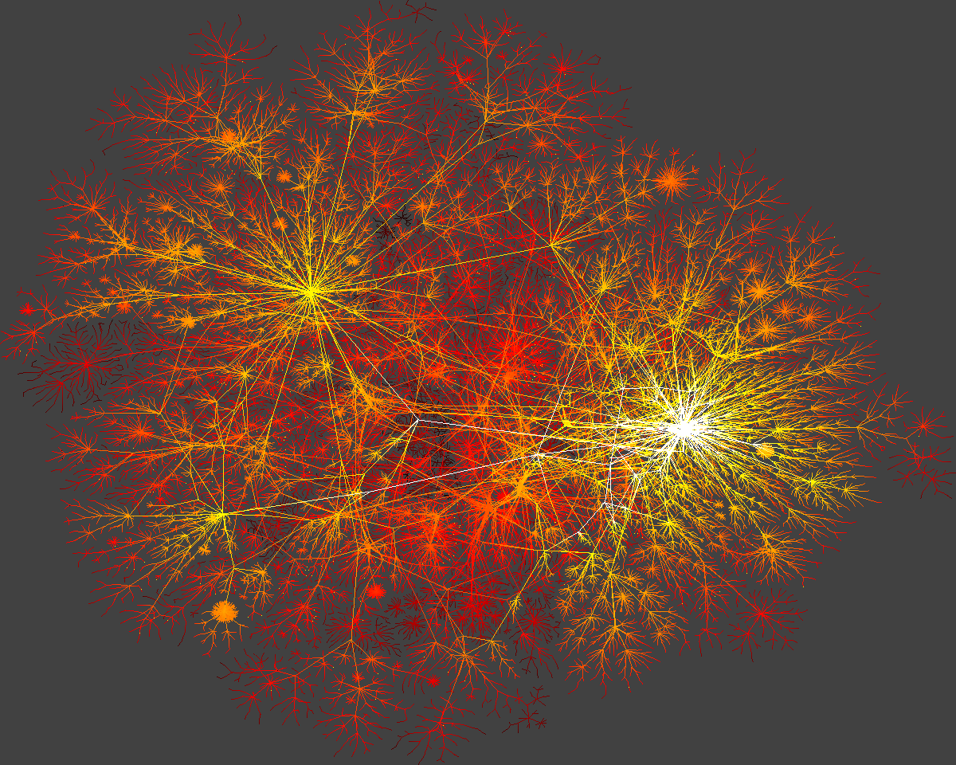
INTERNET
domain2
domain1
router
domain3
Network Science: Introduction

Slide 23
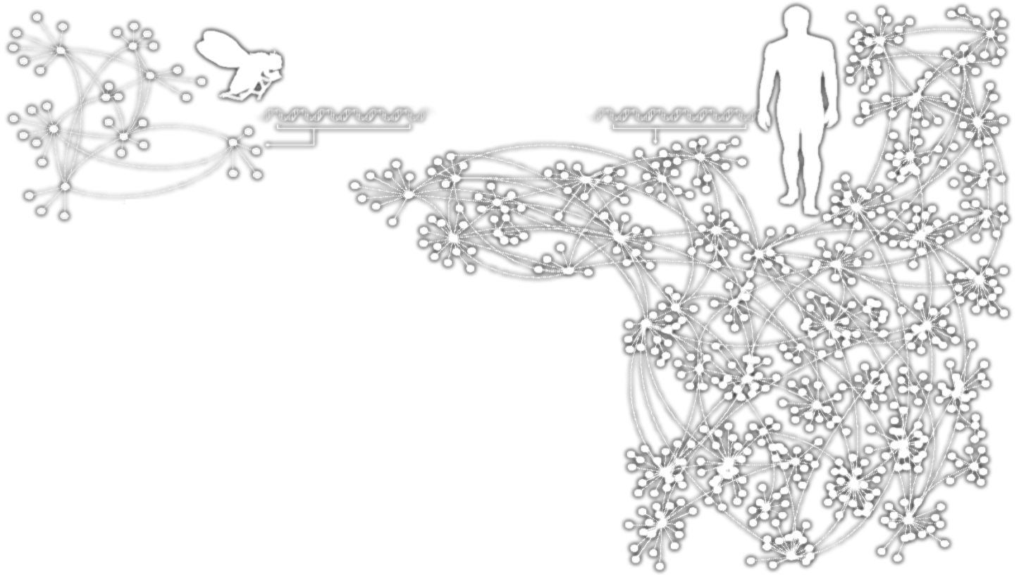
HUMANS GENES
Homo
Sapiens
Drosophila
Melanogaster
In the generic networks shown, the points represent the elements of each organism’s genetic network, and the dotted lines show the interactions between them.
Network Science: Introduction

Slide 24
HUMANS GENES
Homo
Sapiens
Drosophila
Melanogaster
Complex systems
Made of many non-identical elements connected by diverse interactions.
NETWORK
Network Science: Introduction

Slide 25
THE ROLE OF NETWORKS
Behind each system studied in complexity there is an intricate wiring diagram, or a network, that defines the interactions between the component.
We will never understand complex system unless we map out and understand the networks behind them.
Network Science: Introduction

Slide 26
Section 5
TWO FORCES HELPED THE EMERGENCE OF NETWORK SCIENCE
Network Science: Introduction

Slide 27
THE HISTORY OF NETWORK ANALYSIS
Graph theory: 1735, Euler
Social Network Research: 1930s, Moreno
Communication networks/internet: 1960s
Ecological Networks: May, 1979.
Network Science: Introduction
Notes:
Why didn’t network science emerge two hundred years earlier? The networks it explores are by no means new: metabolic networks date back to the origins of life, with a history of four billion years, and the Internet is over four decades old. Furthermore, many disciplines, from bio- chemistry to sociology, and brain science, have been dealing with their notion of networks. Graph theory, a prolific subfield of mathematics, has focused on networks since 1735. Why do we dare to call network science the science of the 21st century?

Slide 28
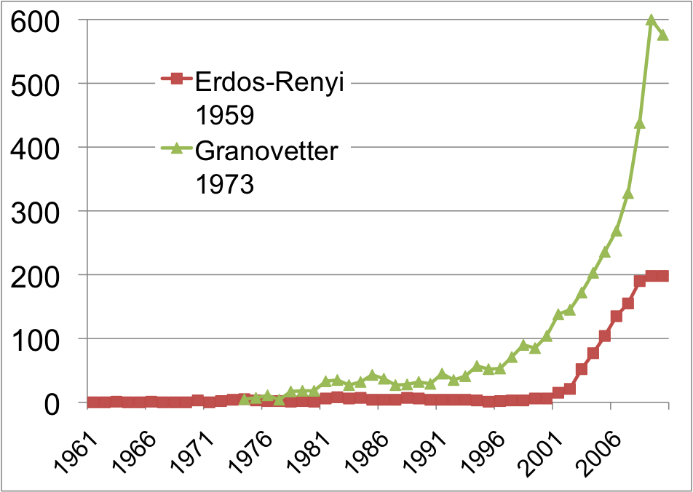
THE HISTORY OF NETWORK ANALYSIS
Network Science: Introduction
Notes:
Something special happened at the dawn of the 21st century that transcended individual research fields and catalyzed the emergence of a new discipline (Image 1.5). To understand why this happened only now, and not two hundred years earlier, we need to discuss the forces that have contributed to the emergence of network science.
While the study of networks has a long history from graph theory to sociology, the modern chapter of network science emerged only during the first decade of the 21st century, following the publication of two seminal papers in 1998 [2] and 1999 [3]. The explosive interest in network science is well documented by the citation pattern of two classic network papers, the 1959 paper by Paul Erdos and Alfréd Rényi that marks the beginning of the study of random networks in graph theory [4] and the 1973 paper by Mark Granovetter, the most cited social network paper [5]. Both papers were hardly or only moderately cited before 2000. The explosive growth of citations to these papers in the 21st century documents the emergence of network science, drawing a new, interdisciplinary audience to these classic publications.

Slide 29
THE EMERGENCE OF NETWORK SCIENCE
The emergence of network maps:
Movie Actor Network, 1998;
World Wide Web, 1999.
C elegans neural wiring diagram 1990
Citation Network, 1998
Metabolic Network, 2000;
PPI network, 2001
Network Science: Introduction
Notes:
The emergence of network maps: To describe the behavior of a system consisting of hundreds to billions of interacting components, we first need a map of the system’s wiring diagram. In a social system, this would require knowing the list of your friends, your friends’ friends, and so on. In the WWW, this map tells us which webpages link to each other. In the cell, this corresponds to a detailed list of binding interactions and reactions that the genes, proteins, and metabolites participate in. In the past, we either lacked the tools to map these networks out, or it was difficult to keep track of the huge amount of data behind these maps. The emergence of the Internet, offering effective and fast data sharing methods, together with cheap digital storage, fundamentally changed this, allows us to collect, assemble, share, and analyze data pertaining to real networks.
While many of the canonical maps studied today in net- work science were not collected with the purpose of studying networks (Box 2):
The list of chemical reactions that take place in a cell were discovered over a 150 year period by biochemists and biologists. In the 1990s they were collected in central databases, offering the first chance to assemble the networks behind a cell.
The list of actors that play in each movie were traditionally scattered in books and encyclopedias. With the advent of the Internet, these disparate data were assembled into a central database by imdb.com, mainly to feed the curiosity of movie aficionados. The database offered the first chance for network scientists to explore the structure of the affiliation network behind Hollywood.
The detailed list of authors of millions of research papers were traditionally scattered in the table of content of thou- sands of journals, but recently the Web of Science, Google Scholar, and other sites assembled them into comprehensive databases, easing the search for scientific information.
We also witnessed an explosion of map making at the end of the 1990s. These offered detailed maps of the networks behind numerous complex system, from cell to the economy. Examples include the CAIDA or DIMES project aimed at obtaining an accurate map of the Internet [8]; the hundreds of millions of dollars spent by biologists to systematically map out protein-protein inter- actions in human cells [6], or the Connectome project of the US National Institute of Health that aims to trace the neural connection in mammalian brains [7].

Slide 30
THE EMERGENCE OF NETWORK SCIENCE
The universality of network characteristics:
The architecture of networks emerging in various domains of science, nature, and technology are more similar to each other than one would have expected.
Network Science: Introduction
Notes:
The universality of network characteristics: It is easy to list the differences between the various networks we encounter in nature or society: the nodes of the metabolic network are tiny molecules and the links are chemical reactions governed by quantum mechanics; the nodes of the WWW are web documents and the links are URLs maintained by computer algorithms; the nodes of the social network are individuals, the links representing family, professionals, friendship, and acquaintance ties.
The processes that shape these networks also differ greatly: metabolic networks are shaped by billions of years of evolution; WWW is collectively built by the actions of mil- lions of individuals; social networks are shaped by social norms whose roots go back thousands of years.
Given this diversity in size, nature, scope, history, and evolution, one would not be surprised if the networks behind these systems would differ greatly. Yet, a key discovery of network science is that the architecture and the evolution of net- works emerging in various domains of science, nature, and technology are rather similar to each other, allowing us to use a common set of mathematical tools to explore these systems.
This universality is one of the guiding principle of this book: we will not only seek to uncover specific network properties, but we will aim to understand its origins, en- coding the laws that shape network evolution, as well as its consequences in understanding network behavior.

Slide 31
Section 6
THE CHARACTERISTICS OF NETWORK SCIENCE
Network Science: Introduction
Notes:
Network science is distinguished, not only by its subject matter, but also by its methodology. In the following we briefly discuss the key characteristics of the approach network science adopted to understand complex systems, helping us better understand the domain we are about to embark on.

Slide 32
THE CHARACTERISTICS OF NETWORK SCIENCE
Interdisciplinary
Empirical
Quantitative and Mathematical
Computational
Network Science: Introduction
Notes:
Interdisciplinary nature: Network science offers a language through which different disciplines can seamlessly interact with each other. Indeed, cell biologists and computer scientists alike are faced with the task of characterizing the wiring diagram behind their system, extracting information from incomplete and noisy datasets, and the need to understand their systems’ robustness to failures or deliberate attacks.
To be sure, each discipline brings along a different set of technical details and challenges, which are important on their own. Yet, the common character of the many issues various fields struggle with have led to a cross-disciplinary fertilization of tools and ideas. For example, the concept of betweenness centrality that emerged in the social network literature in the 1970s, today plays a key role in identifying high traffic nodes on the Internet; algorithms developed by computer scientists for graph partitioning have found novel applications in cell biology.

Slide 33
THE CHARACTERISTICS OF NETWORK SCIENCE
Interdisciplinary
Empirical, data driven
Quantitative and Mathematical
Computational
Network Science: Introduction
Notes:
Empirical, data driven nature: The tools of network science have their roots in graph theory, a fertile field of mathematics. What distinguishes network science from graph theory is its empirical nature, i.e. its focus on data and utility. As we will see in the coming chapters, we will never be satisfied with developing the abstract mathematical tools to describe a certain network property. Each tool we develop will be tested on real data and its value will be judged by the insights it offers about a system’s structure or evolution.

Slide 34
THE CHARACTERISTICS OF NETWORK SCIENCE
Interdisciplinary
Empirical
Quantitative and Mathematical
Computational
Network Science: Introduction
Notes:
Quantitative and mathematical nature: To contribute to the development of network science, it is essential to master the mathematical tools behind it. The tools of network science borrowed the formalism to deal with graphs from graph theory and the conceptual framework to deal with randomness and seek universal organizing principles from statistical physics. Lately, the field is benefiting from concepts borrowed from engineering, control and information theory, statistics and data mining, helping us ex- tract information from incomplete and noisy datasets.

Slide 35
THE CHARACTERISTICS OF NETWORK SCIENCE
Interdisciplinary
Empirical
Quantitative and Mathematical
Computational
Network Science: Introduction
Notes:
Computational nature: Finally, given the size of many of the networks we explore, and the exceptional amount of data behind them, network science offers a series of formidable computational challenges. Hence, the field has a strong computational character, actively borrowing from algorithms, database management and data mining. A series of software tools help practitioners with diverse computational skills analyze networks.

Slide 36
Section 7
THE IMPACT OF NETWORK SCIENCE
Network Science: Introduction
Notes:
The impact of a new research field is measured both by its intellectual achievements as well as by the reach and the potential of its applications. While network science is a young field, its impact is everywhere around us, as we discuss below.

Slide 37

ECONOMIC IMPACT
Google
Market Cap(2010 Jan 1):
$189 billion
Cisco Systems
networking gear Market cap (Jan 1, 2919):
$112 billion
Facebook
market cap:
$50 billion
www.bizjournals.com/austin/news/2010/11/15/facebooks... - Cached
Network Science: Introduction
Notes:
Economic Impact: From web search to social networking.
Some of the most successful companies of the 21st century, from Google to Facebook, Twitter, LinkedIn, Cisco to Apple and Akamai, base their technology and business model on networks. Indeed, Google is not only the biggest network mapping operation, building a comprehensive map of the WWW, but its search technology relies on the network characteristics of the Web.
Networks have gained particular popularity with the emergence of Facebook, the company with the oft-emphasized ambition to map out the social network of the whole planet. While Facebook was not the first social networking site, it is likely also not the last: an extensive ecosystem of social networking tools, from Twitter to Orkut, are attracting an impressive number of users (Image 1.6). The tools developed by network science fuel these sites, aiding everything from friend recommendation to advertising.

Slide 38
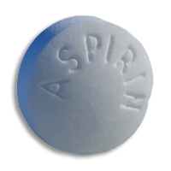
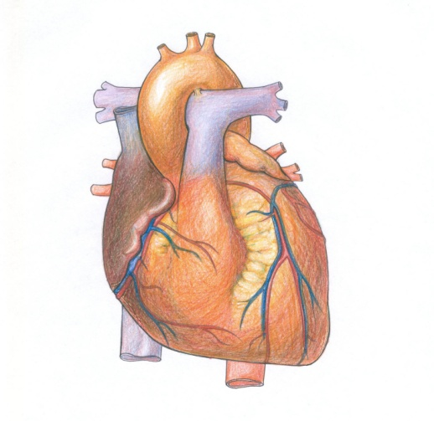
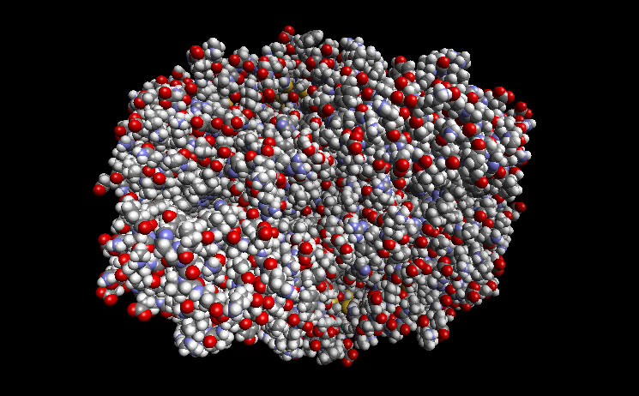
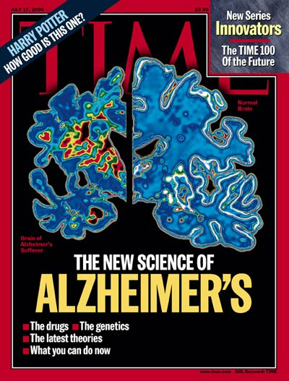
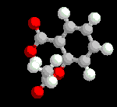
DRUG DESIGN, METABOLIC ENGINEERING:
Reduces
Inflammation
Fever
Pain
Prevents
Heart attack
Stroke
COX2
Causes
Bleeding
Ulcer
Reduces the risk of
Alzheimer's Disease
Reduces the risk of
breast cancer
ovarian cancers
colorectal cancer
Network Science: Introduction
Notes:
Health: From drug design to metabolic engineering.
The human genome project, completed in 2001, offered the first comprehensive list of all human genes. Yet, to fully understand how our cells function, and the origin of disease, we need accurate maps that tell us how these genes and other cellular components interact with each other. Most cellular processes, from the processing of food by our cells to sensing changes in the environment, rely on molecular networks. The breakdown of these networks is responsible for most human diseases. This has led to the emergence of network biology, a new subfield of biology that aims to understand the behavior of cellular networks. A parallel movement within medicine, called network medicine, aims to uncover the role of networks in human disease (Image 1.7a/b). Networks are particularly import- ant in drug development. The ultimate goal of network pharmacology is to develop drugs that can cure diseases without significant side effects. This goal is pursued at many levels, from millions of dollars invested to map out cellular networks to the development of tools and databas- es to store, curate, and analyze patient and genetic data. Several new companies take advantage of these opportuni- ties, from GeneGo that aims to collect accurate maps of celllular interactions from scientific literature to Genomatica that uses the predictive power behind metabolic networks to identify drug targets in bacteria and humans. Recently most major pharmaceutical companies have made significant investments in network and systems medicine, seeing it as the path towards future drugs.

Slide 39
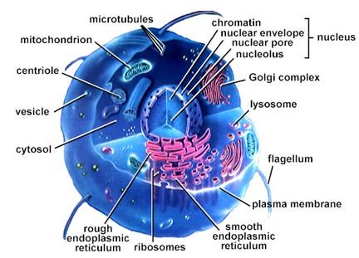
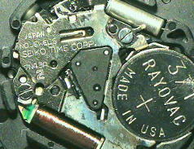
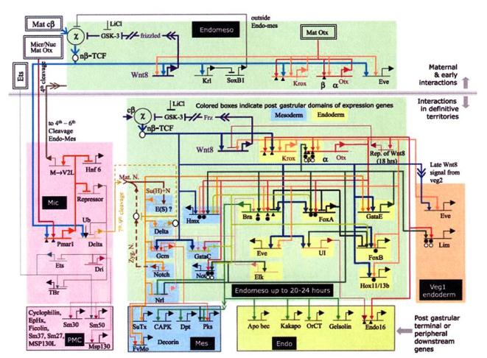
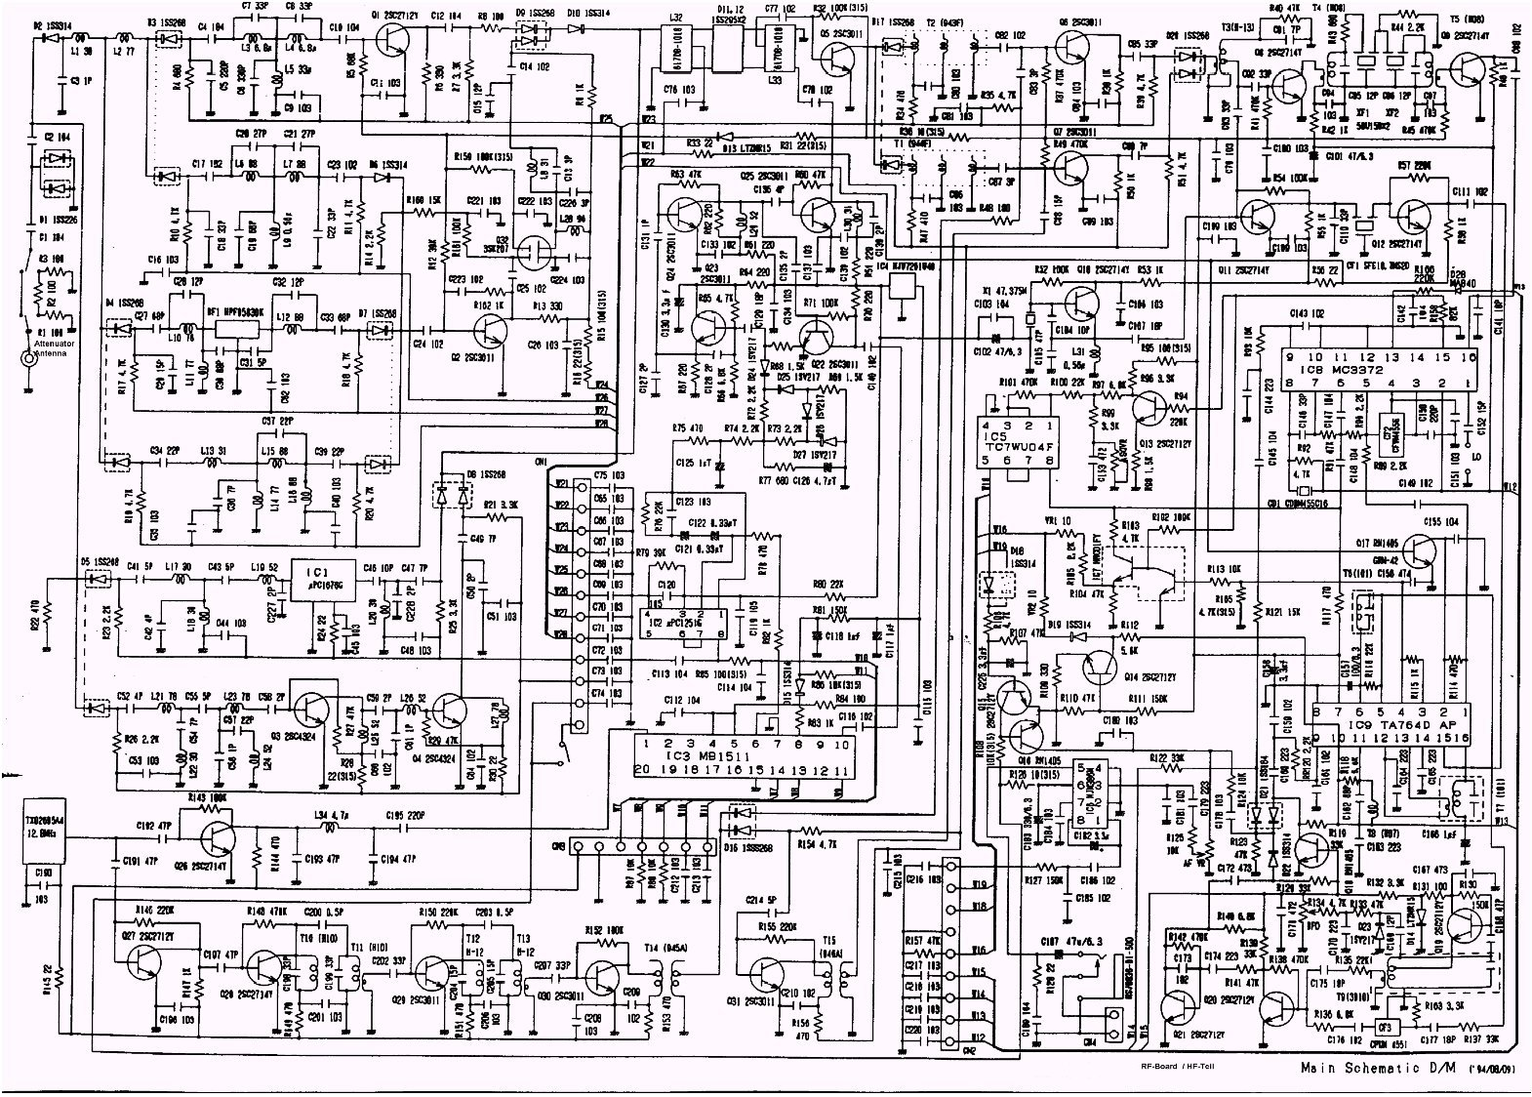
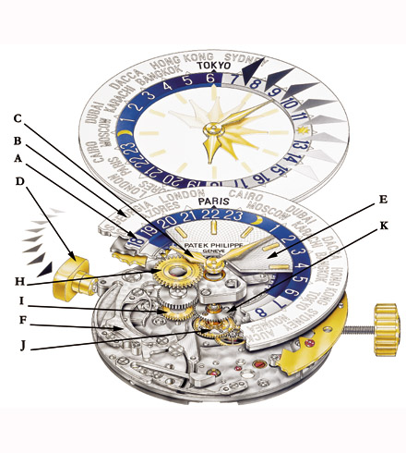
DRUG DESIGN, METABOLIC ENGINEERING:
Notes:
Health: From drug design to metabolic engineering.
The human genome project, completed in 2001, offered the first comprehensive list of all human genes [9, 10]. Yet, to fully understand how our cells function, and the origin of disease, we need accurate maps that tell us how these genes and other cellular components interact with each other. Most cellular processes, from the processing of food by our cells to sensing changes in the environment, rely on molecular networks. The breakdown of these networks is responsible for most human diseases. This has led to the emergence of network biology, a new subfield of biology that aims to understand the behavior of cellular networks. A parallel movement within medicine, called network medicine, aims to uncover the role of networks in human disease (Image 1.7a/b). Networks are particularly import- ant in drug development. The ultimate goal of network pharmacology is to develop drugs that can cure diseases without significant side effects. This goal is pursued at many levels, from millions of dollars invested to map out cellular networks to the development of tools and databases to store, curate, and analyze patient and genetic data. Several new companies take advantage of these opportunities, from GeneGo that aims to collect accurate maps of cellular interactions from scientific literature to Genomatica that uses the predictive power behind metabolic networks to identify drug targets in bacteria and humans. Recently most major pharmaceutical companies have made significant investments in network and systems medicine, seeing it as the path towards future drugs.

Slide 40
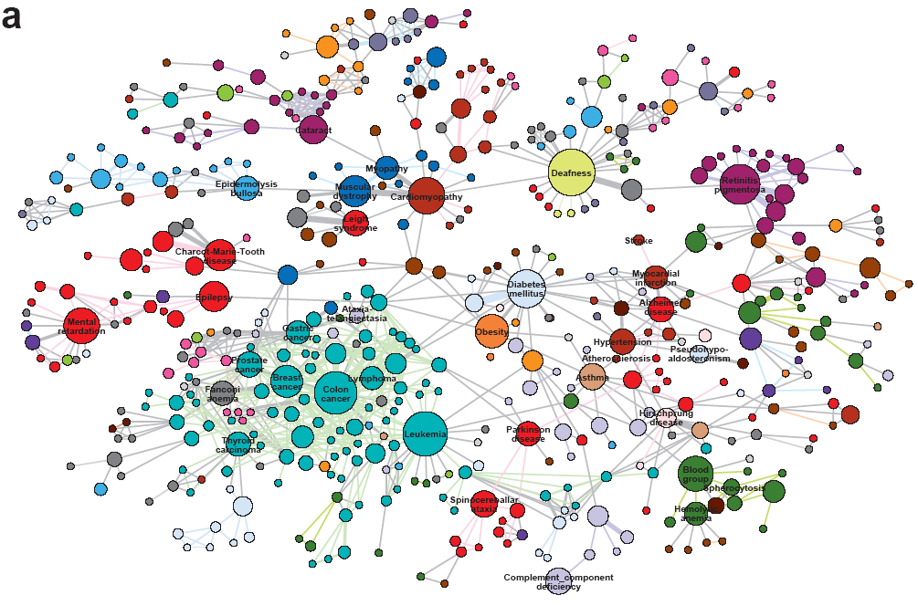
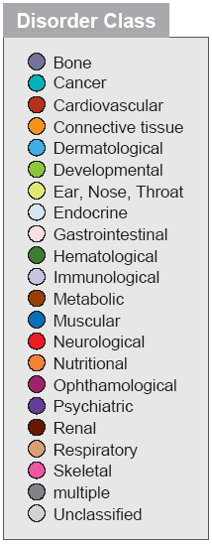
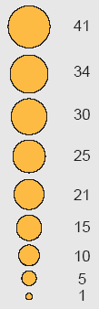
HUMAN DISEASE NETWORK
Notes:
Health: From drug design to metabolic engineering.
The human genome project, completed in 2001, offered the first comprehensive list of all human genes [9, 10]. Yet, to fully understand how our cells function, and the origin of disease, we need accurate maps that tell us how these genes and other cellular components interact with each other. Most cellular processes, from the processing of food by our cells to sensing changes in the environment, rely on molecular networks. The breakdown of these networks is responsible for most human diseases. This has led to the emergence of network biology, a new subfield of biology that aims to understand the behavior of cellular networks. A parallel movement within medicine, called network medicine, aims to uncover the role of networks in human disease (Image 1.7a/b). Networks are particularly import- ant in drug development. The ultimate goal of network pharmacology is to develop drugs that can cure diseases without significant side effects. This goal is pursued at many levels, from millions of dollars invested to map out cellular networks to the development of tools and databas- es to store, curate, and analyze patient and genetic data. Several new companies take advantage of these opportuni- ties, from GeneGo that aims to collect accurate maps of celllular interactions from scientific literature to Genomatica that uses the predictive power behind metabolic networks to identify drug targets in bacteria and humans. Recently most major pharmaceutical companies have made significant investments in network and systems medicine, seeing it as the path towards future drugs.

Slide 41


Network Biology/Network Medicine
Notes:
Networks in biology and medicine.
a) The cover of two issues of Nature Reviews Genetics, the top review journal in genetics. The cover from 2004, focuses on network biology [11], the cover from 2011 discuses network medicine [12].
b) The prominent role networks play in both cell biology and medical research is illustrated by the fact that the 2004 article on network biology is the second most cited article in the history of Nature Reviews Genetics.

Slide 42



FIGHTING TERRORISM AND MILITARY
http://www.slate.com/id/2245232
Network Science: Introduction
Notes:
Security: Fighting Terrorism.
Terrorism is one of the maladies of the 21st century, absorbing significant resources to combat it worldwide. Network thinking is increasingly present in the arsenal of various law enforcement agencies in charge of limiting terrorist activities. It is used to disrupt the financial network of terrorist organizations, to map terrorist networks, and to uncover the role of their members and their capabilities. While much of the work in this area is classified, several success stories have surfaced. Examples include the use of social networks to capture Saddam Hussein or the capture of the individuals behind the March 11, 2004 Madrid train bombings through the examination of the mobile call net- work.

Slide 43
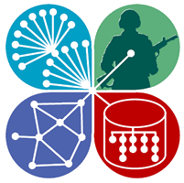

FIGHTING TERRORISM AND MILITARY
http://www.ns-cta.org/ns-cta-blog/
Network Science: Introduction
Notes:
Network concepts have impacted military doctrine as well, leading to the concept of net-war, aimed at fighting low intensity conflicts and crime waged by terrorist and criminal networks that employ decentralized flexible net- work structures [13]. One of the first network science pro- grams at the college level was started at West Point, the US Army’s military academy. In 2009 the Army Research Lab and the Department of Defense devoted over $300 million to support network science centers across the US.

Slide 44
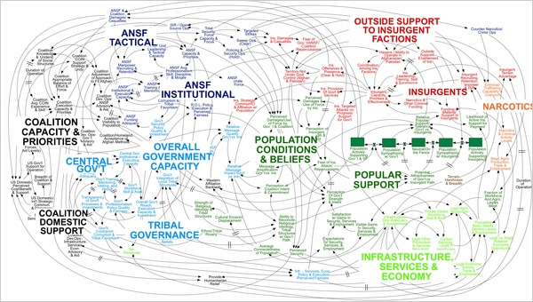
The network behind a military engagement
Network Science: Introduction
Notes:
The network behind a military engagement.
This diagram was designed during the Afghan war to portray the American strategy in Afghanistan. While it has been occasionally ridiculed in the press, it portrays well the complexities and the interconnected nature of a military’s engagement. (Image from New York Times)

Slide 45
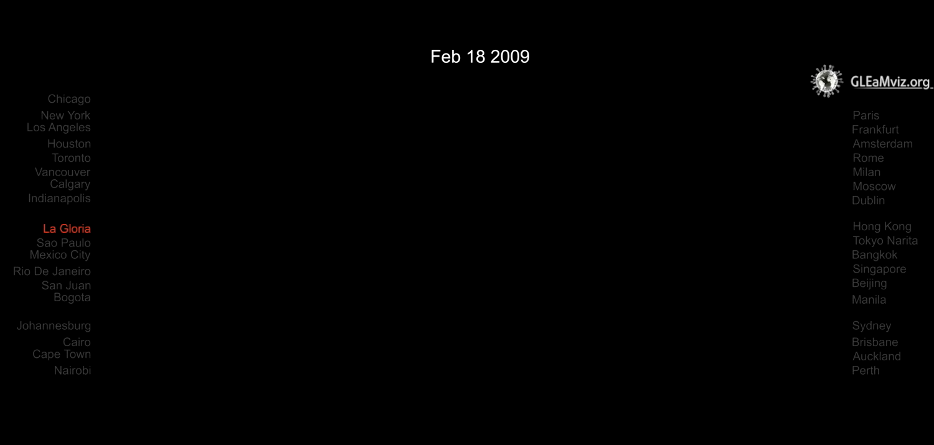
Thex
Predicting the H1N1 pandemic
Network Science: Introduction
Notes:
Epidemics: From forecasting to halting deadly viruses.
While the H1N1 pandemic was not as devastating as it was feared at the beginning of the outbreak in 2009, it gained a special role in the history of epidemics: it was the first pandemic whose course and time evolution was accurately predicted months before the pandemic reached its peak (Image 1.9) [14]. This was possible thanks to fundamental advances in understanding the role of networks in the spread of viruses. Indeed, before 2000 epidemic modeling was dominated by compartment models, assuming that everyone can infect everyone else one word the same socio-physical compartment. The emergence of a network-based framework has fundamentally changed this, offering a new level of predictability in epidemic phenomena.
Today epidemic prediction is one of the most active applications of network science. It is the source several fundamental results, covered in this book, that are used to predict the spread of both biological and electronic viruses. The impact of these advances are felt beyond biological viruses. In January 2010 network science tools have predicted the conditions necessary for the emergence of viruses spreading through mobile phones. The first major mobile epidemic outbreak that started in the fall of 2010 in China, infecting over 300,000 phones each day, closely followed the predicted scenario.

Slide 46
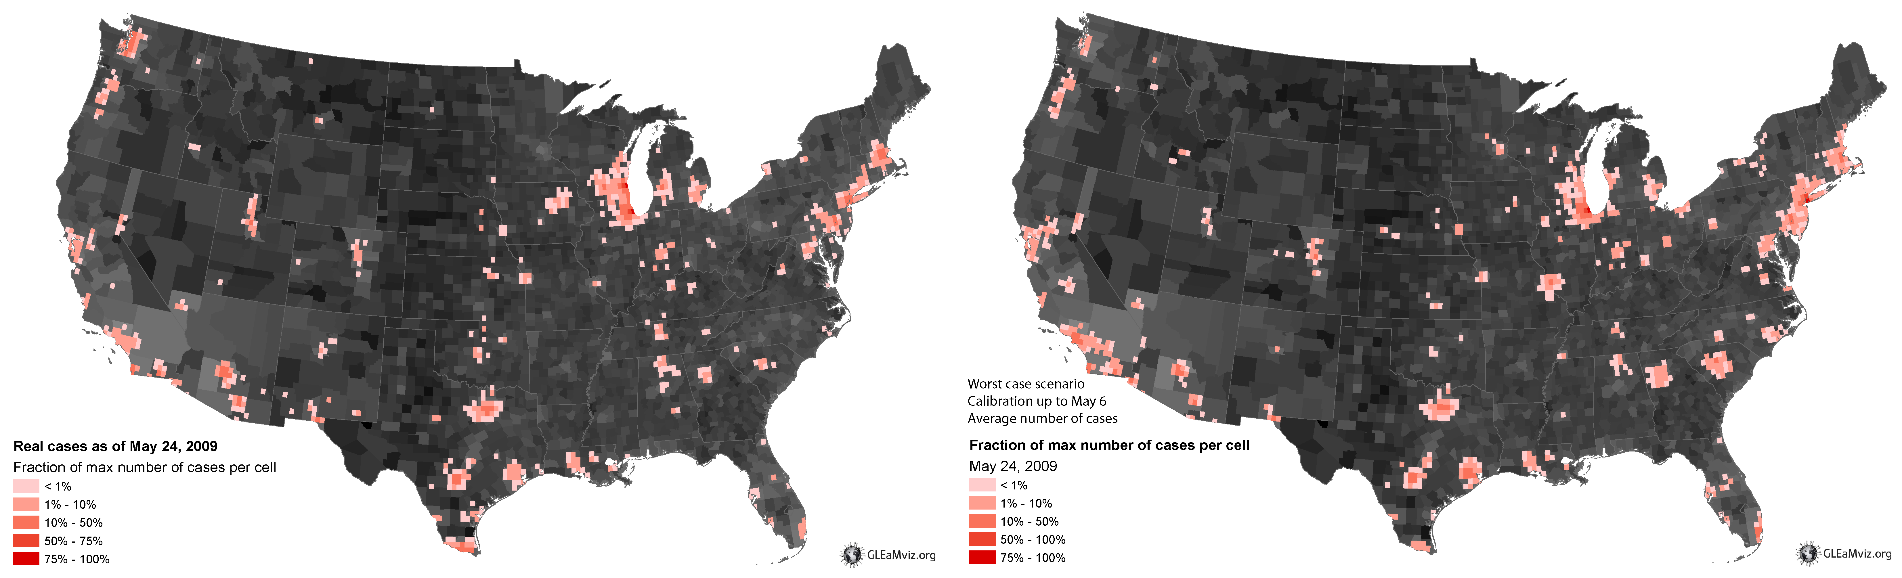
EPIDEMIC FORECAST Predicting the H1N1 pandemic
Real
Projected
Network Science: Introduction
Notes:
Epidemics: From forecasting to halting deadly viruses.
While the H1N1 pandemic was not as devastating as it was feared at the beginning of the outbreak in 2009, it gained a special role in the history of epidemics: it was the first pandemic whose course and time evolution was accurately predicted months before the pandemic reached its peak (Image 1.9). This was possible thanks to fundamental advances in understanding the role of networks in the spread of viruses. Indeed, before 2000 epidemic modeling was dominated by compartment models, assuming that everyone can infect everyone else one word the same socio-physical compartment. The emergence of a net- work-based framework has fundamentally changed this, offering a new level of predictability in epidemic phenomena.
Today epidemic prediction is one of the most active applications of network science [15, 16]. It is the source several fundamental results, covered in this book, that are used to predict the spread of both biological and electronic viruses. The impact of these advances are felt beyond biological viruses. In January 2010 network science tools have predicted the conditions necessary for the emergence of viruses spreading through mobile phones [17]. The first major mobile epidemic outbreak that started in the fall of 2010 in China, infecting over 300,000 phones each day, closely followed the predicted scenario.

Slide 47
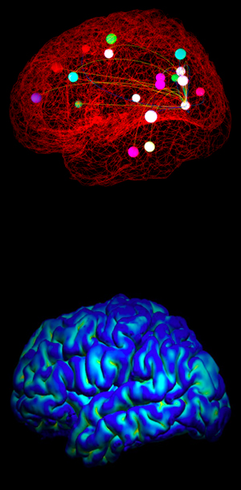
Thex
BRAIN RESEARCH
In September 2010 the National Institutes of Health awarded $40 million to researchers at Harvard, Washington University in St. Louis, the University of Minnesota and UCLA, to develop the technologies that could systematically map out brain circuits.
The Human Connectome Project (HCP) with the ambitious goal to construct a map of the complete structural and functional neural connections in vivo within and across individuals.
http://www.humanconnectomeproject.org/overview/
Network Science: Introduction
Notes:
Brain Research: Mapping neural network.
The human brain, consisting of hundreds of billions of interlinked neurons, is one of the least understood net- works from the perspective of network science. The reason is simple: we lack maps telling us which neurons link to each other. The only fully mapped neural map available for research is that of the C.Elegans worm, with only 300 neurons. Should detailed maps of mammalian brains become available, brain research could become the most prolific application area of network science. Driven by the potential impact of such maps, in 2010 the National Institutes of Health has initiated the Connectome project, aimed at developing the technologies that could provide an accurate neuron-level map of mammalian brains.

Slide 48
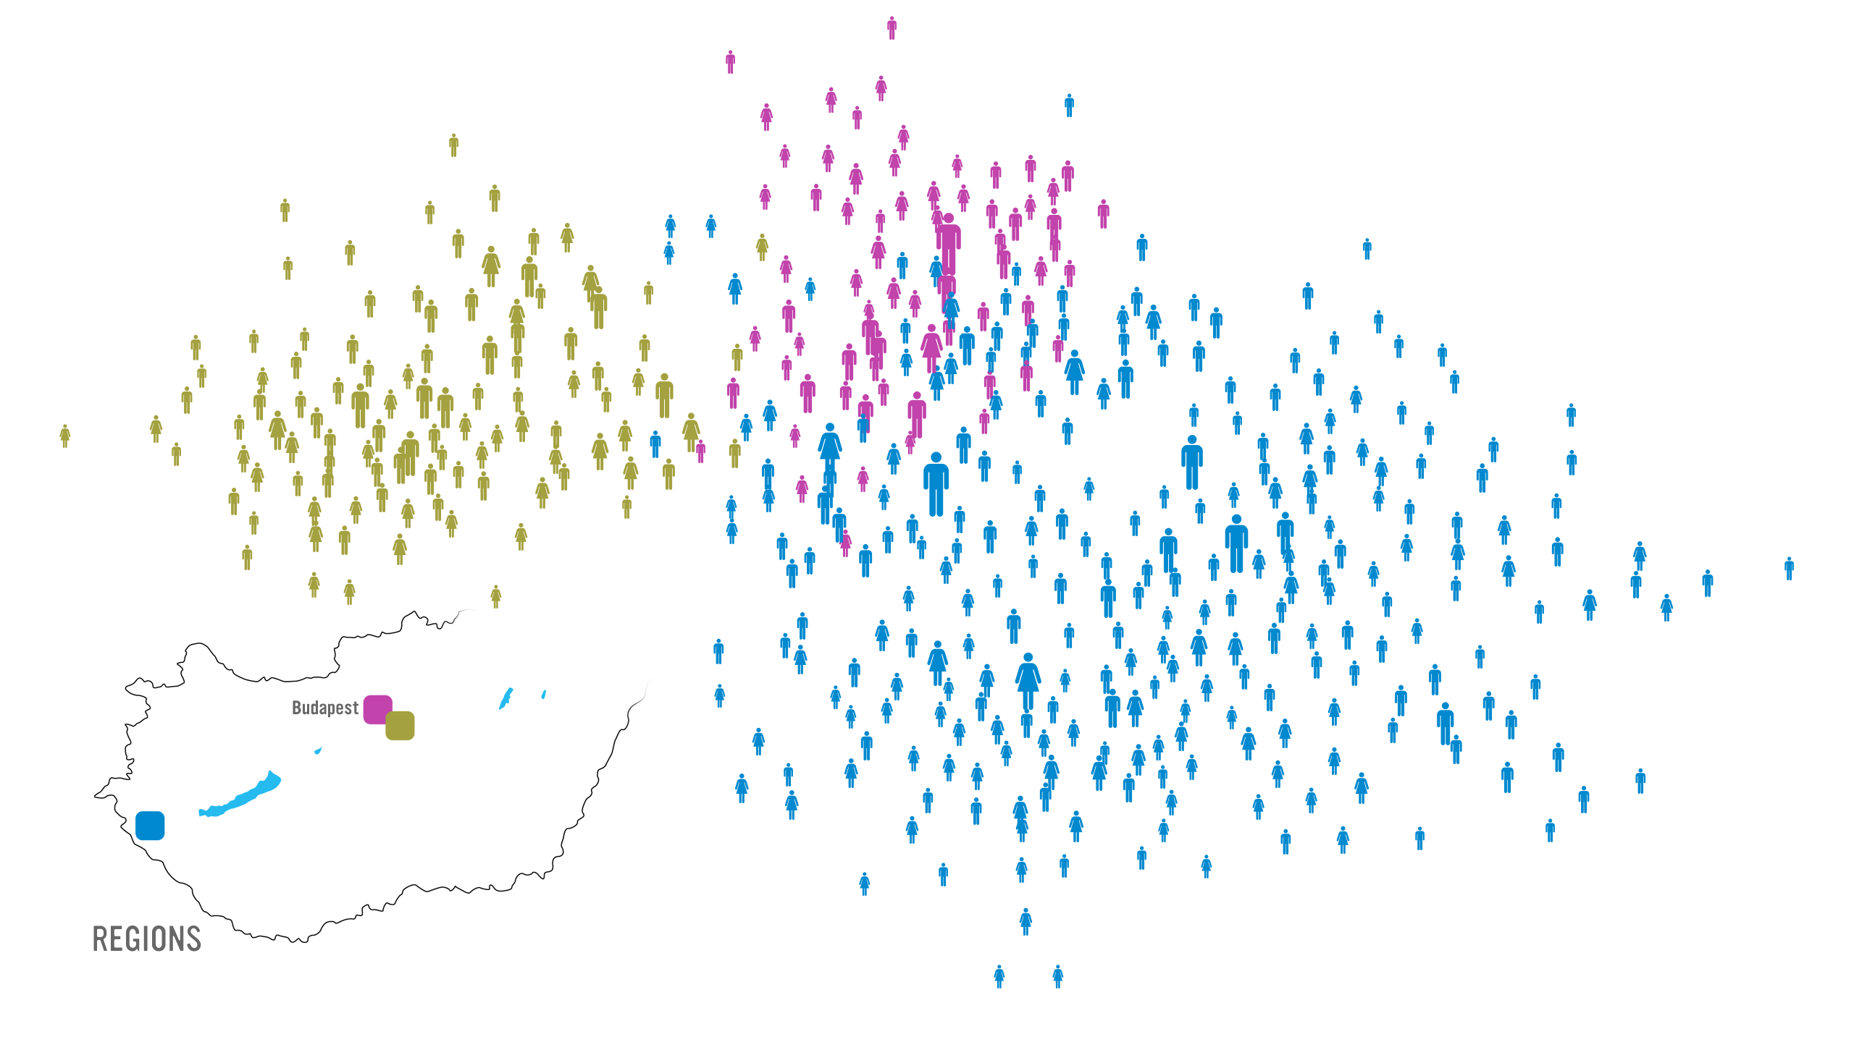

Management
Barabasi Lab
Notes:
While traditionally management uses the official chain of command to understand the inner structure of an organization, it is increasingly evident that the informal network, capturing who really communicates with whom, matters even more for the success of a company. Accurate maps of this network can expose lack of communication between key units, can identify individuals who play an outsize role in bringing different departments and products together, and help higher management diagnose diverse organizational issues. Furthermore, there is increasing evidence in the management literature that the position of an employee within this network correlates with his/her productivity [18].
Therefore, several dozen consulting companies have emerged with expertise to map out the true structure of an organization. Established consulting firms, from IBM to SAP, have added social networking capabilities to their consulting business. These companies offer a host of services, from identifying opinion leaders to preventing employee churn and from identifying optimal groups for a task to modeling product diffusion (Image 1.10a/b/c/d). Hence lately network science tools are increasingly indispensable in management and business, enhancing productivity and boosting innovation within an organization.
Network science can therefore offer a microscope for higher management, helping them improve the company’s effectiveness by uncovering the true network behind any organization.
30 Let me show you how this works. Start from the list of a company’s employees, colored based on their location. This happens to be a Hungarian company that has three locations, one on Budapest and two others outside of the city.
This is not enough, however: To apply network science, we need a network: we need to know who listens to whom, who is asking for advice from whom. So a social network company, Maven 7, asked each employee: Whom do you ask for advice when it comes to decisions that impact the company, like, restructuring, advancement, and so on?

Slide 49
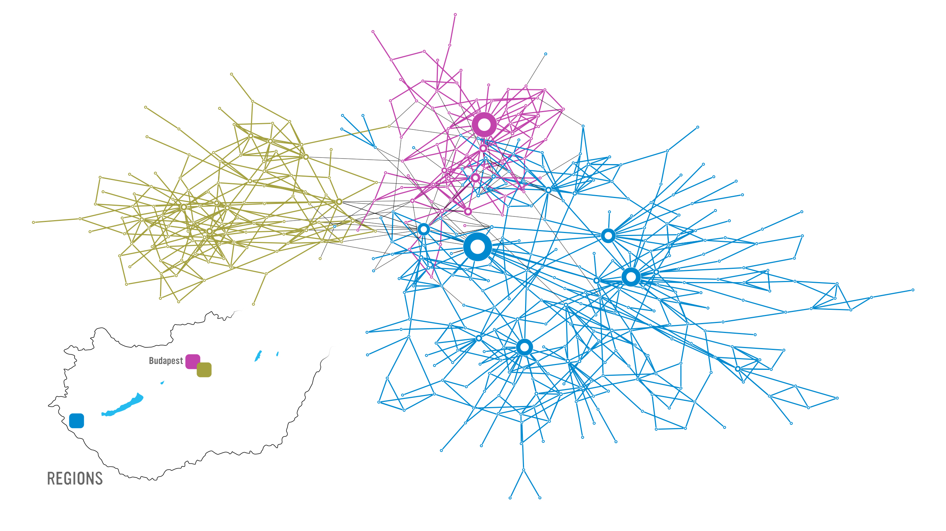
Barabasi Lab
Notes:
30 Why did they do map in the first place? The company had a major internal communication problem. The decisions of the higher management did not arrive to the workers, or what arrived had nothing do to with the real decisions. They wanted to find out where was the problem.
The map showed that several individuals do have quite a bit of influence in the company. They are the hubs. The problem was that none of the hubs were part of the leadership.

Slide 50
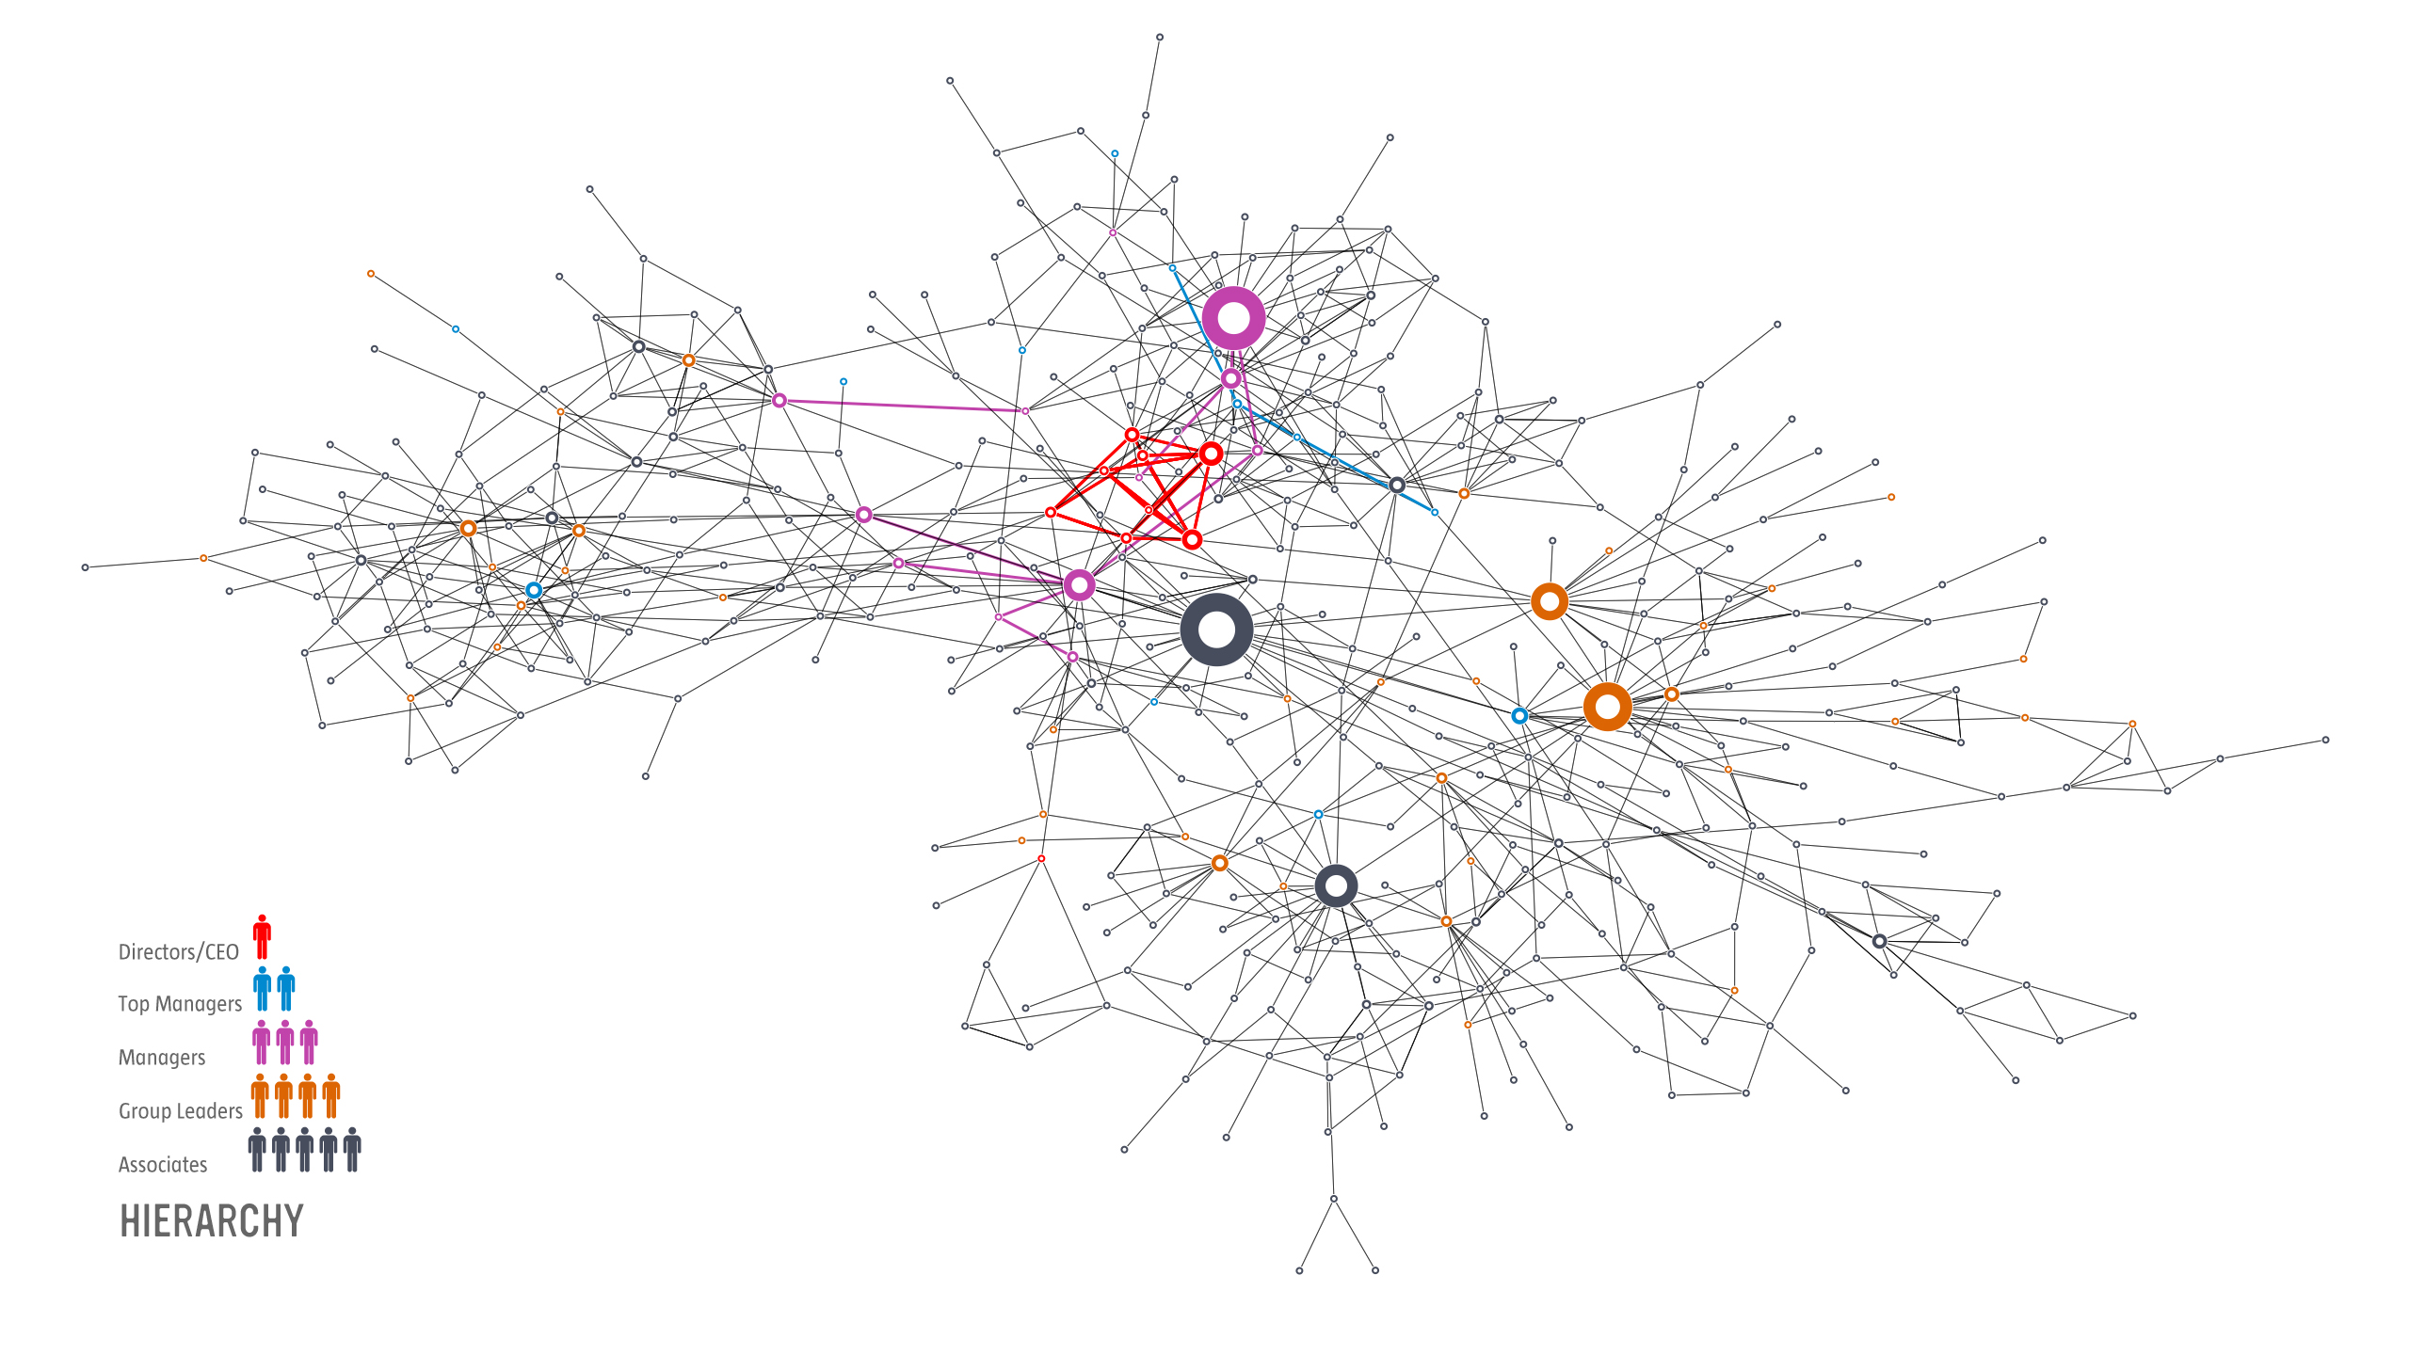
Barabasi Lab
Notes:
30: This is obvious here, where we colored the nodes based on their rank. The biggest hubs are not the company directors or the CEO. They are not part of the top management. Most are associates, a kind way to say, workers.
Who has the biggest influence? The safety and environmental manager. The only person whose job was to visit each location and talk with everyone. He had no links to the higher management. He was passing on information as collected along his trail. He was the oracle, running a gossip center.
So fire the guy? Well, he is not the problem. The problem is that higher management failed to put in place proper channels of communication, leaving behind a structural hole, which this fellow filled in.
But what does this have to do with control?

Slide 51
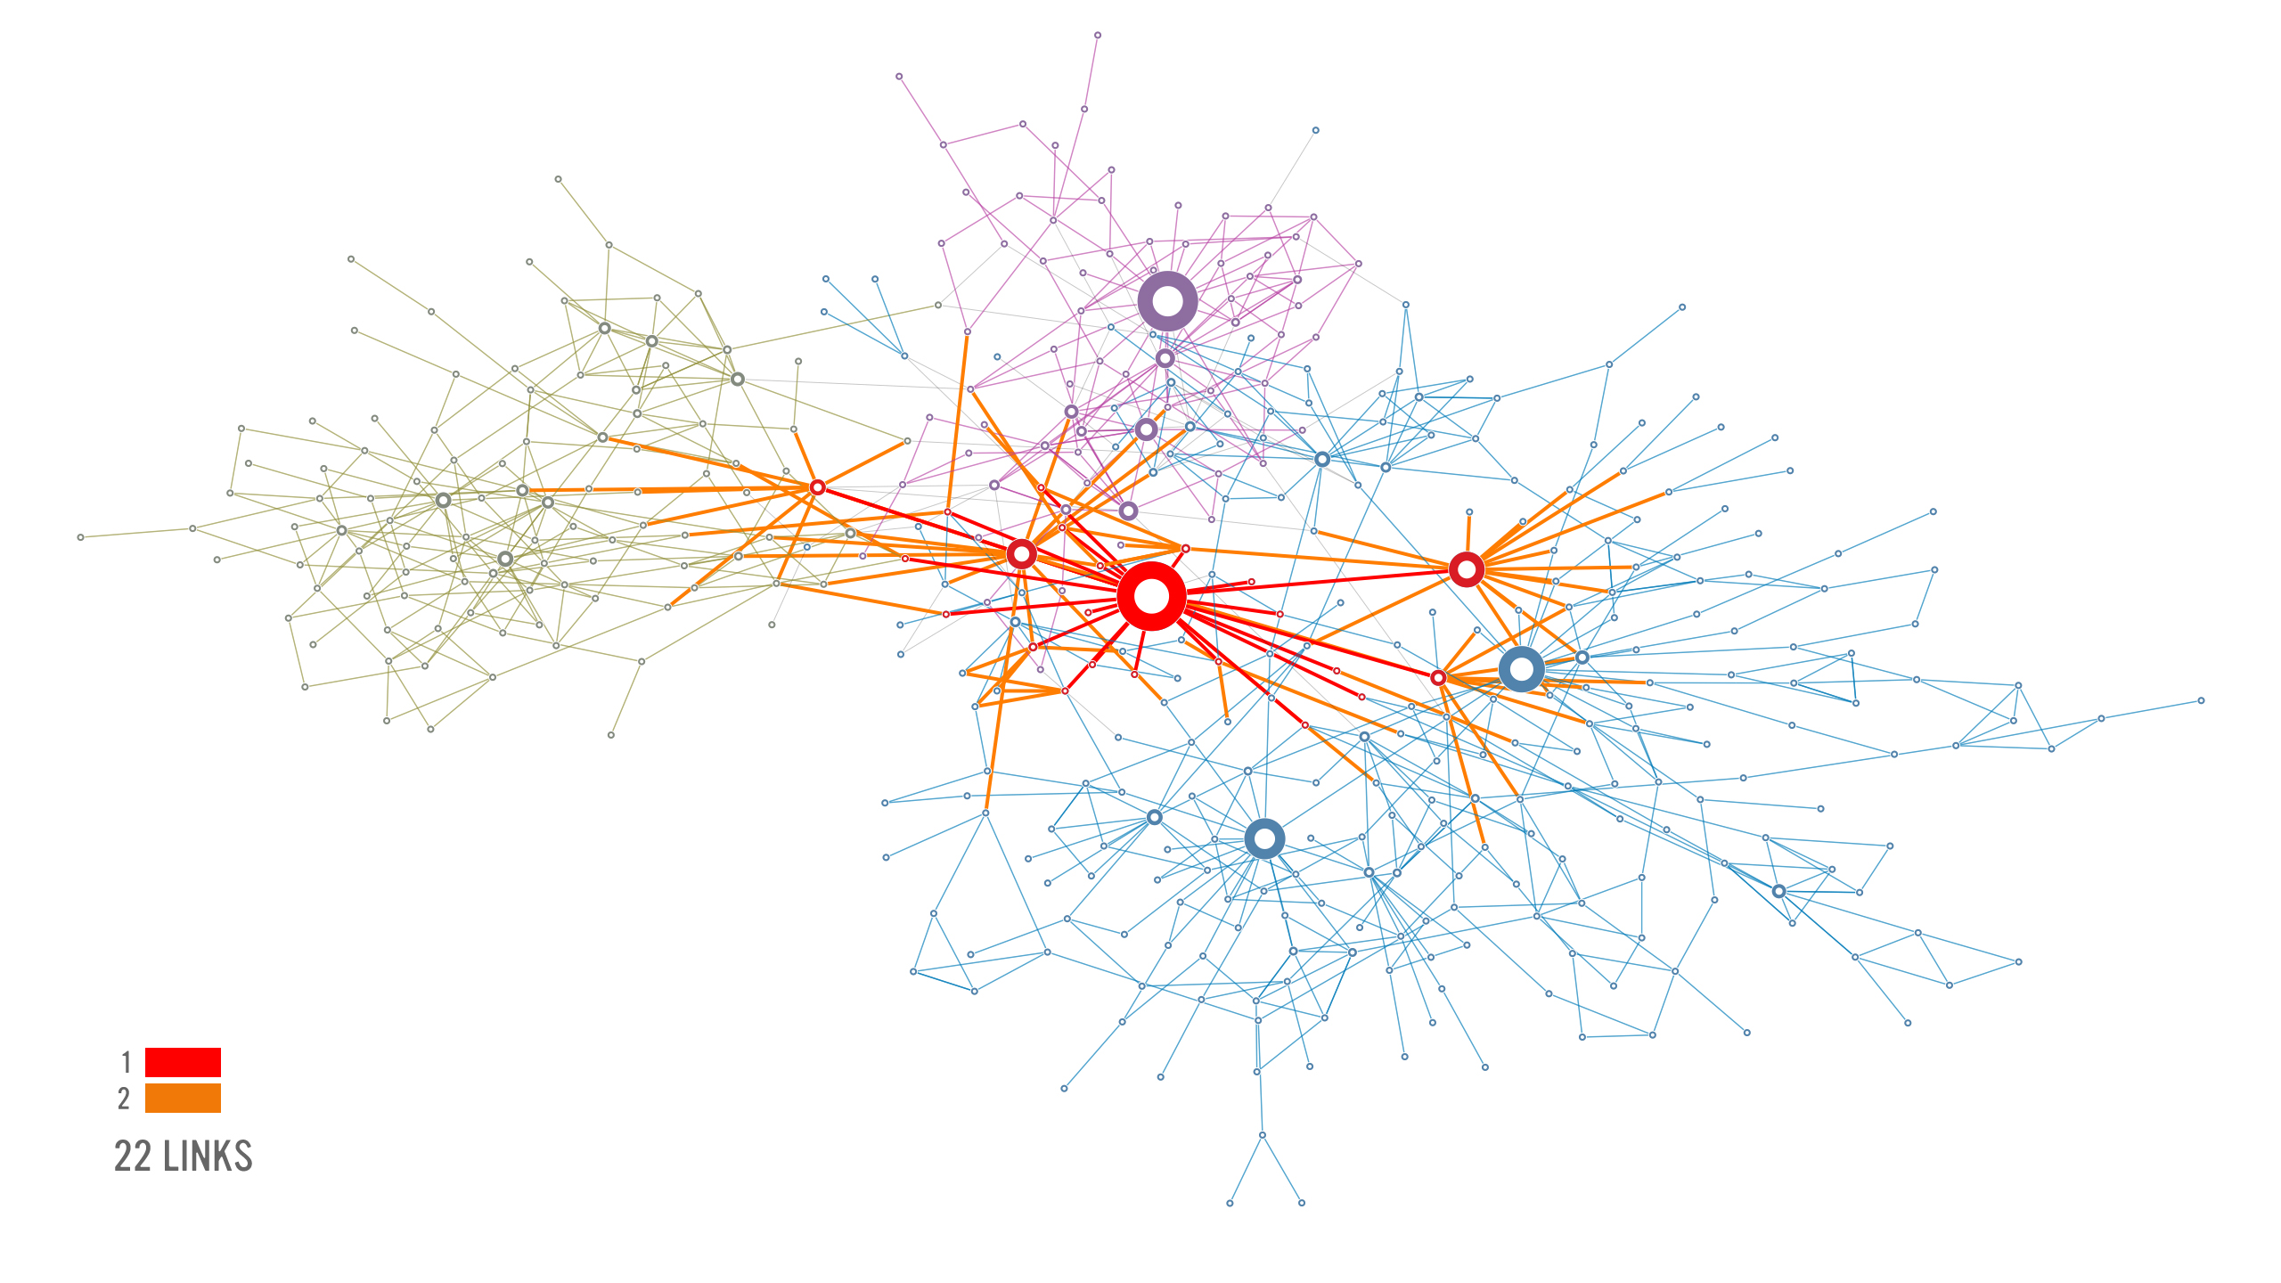

Slide 52
Section 8
SCIENTIFIC IMPACT
Network Science: Introduction
Notes:
Nowhere is the impact of network thinking more evident than in the scientific community. The most prominent scientific journals, from Nature and Science to Cell and PNAS, have devoted special issues, reviews, or editorials address- ing the impact of networks on various topics from biology to social sciences. During the past decade, each year several dozen international conferences, workshops, summer and winter schools have focused exclusively on network sci- ence. A successful network science meeting series, called NetSci, attracts the field’s practitioners since 2005. Several general-interest books, making the bestseller lists in many countries, have brought network science to the public. Most major universities offer network science courses, attracting a diverse student body.

Slide 53
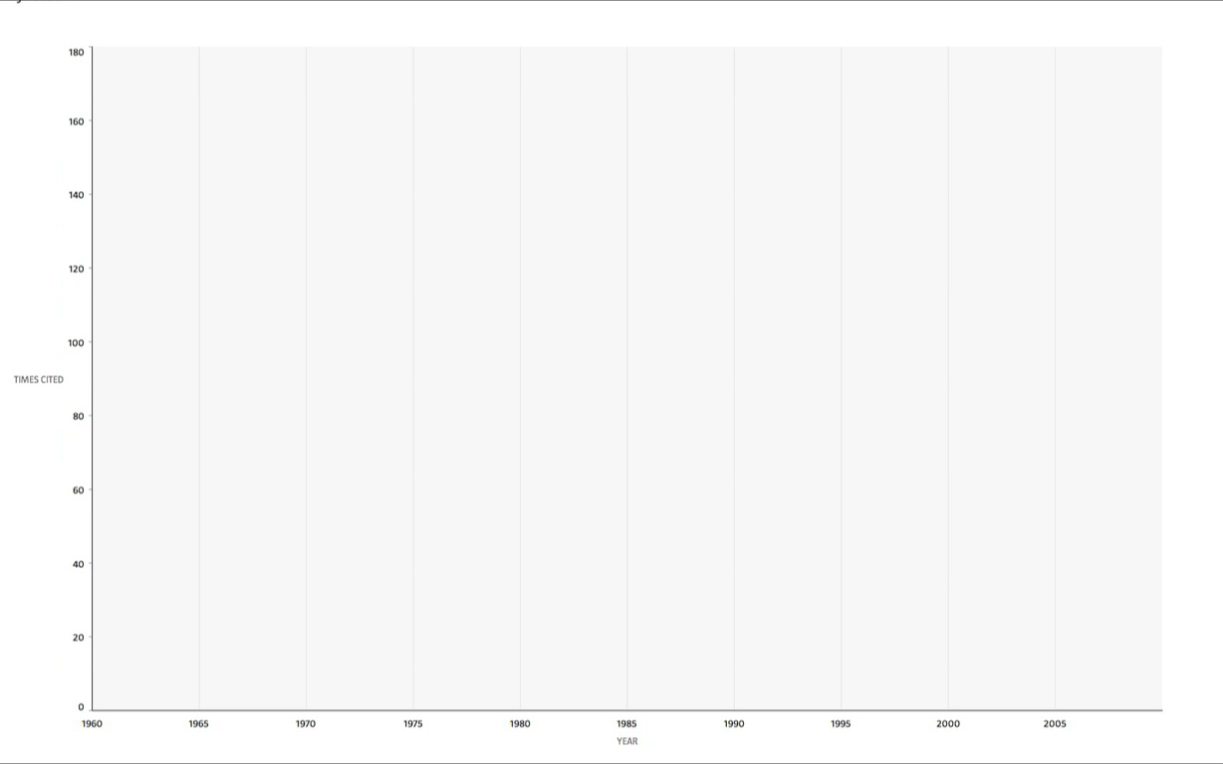
NETWORK SCIENCE The science of the 21st century
Times
cited
Years
Network Science: Introduction

Slide 54
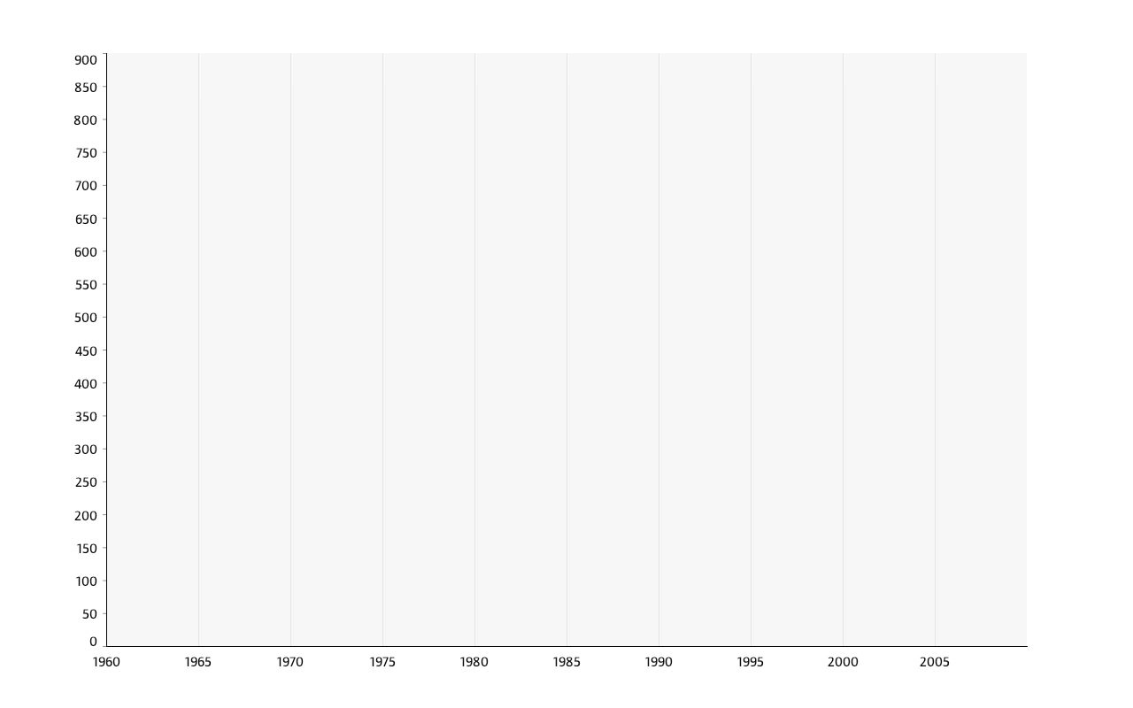
NETWORK SCIENCE The science of the 21st century
Times
cited
Years
Network Science: Introduction

Slide 55

Complex systems and networks.
Science:
Special Issue for the 10 year anniversary of Barabas i& Albert 1999 paper.
Network Science: Introduction
Notes:
Complex systems and networks.
Special issue of Science magazine on Complex Systems and Networks, published on July 24, 2009, marking the 10th anniversary of the 1999 discovery of scale-free networks [3].

Slide 56
Original papers:
1998: Watts-Strogatz paper in the most cited Nature publication from 1998; highlighted by ISI as one of the ten most cited papers in physics in the decade after its publication.
1999: Barabasi and Albert paper is the most cited Science paper in 1999;highlighted by ISI as one of the ten most cited papers in physics in the decade after its publication.
2001: Pastor -Satorras and Vespignani is one of the two most cited papers among the papers published in 2001 by Physical Review Letters.
2002: Girvan-Newman is the most cited paper in 2002 Proceedings of the National Academy of Sciences.
Network Science: Introduction

Slide 57


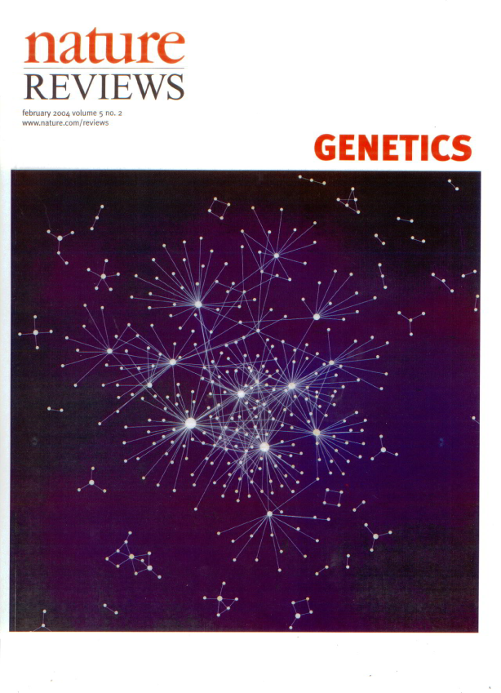
REVIEWS:
The first review of network science by Albert and Barabasi, 2001) is the second most cited paper published in Reviews of Modern Physics, the highest impact factor physics journal, published since 1929. The most cited is Chandaseklar’s 1944 review on solar processes, but it will be surpassed by the end of 2012 by Albert et al.
The SIAM review of Newman on network science is the most cited paper of any SIAM journal.
BIOLOGY: “Network Biology”, by Barabasi and Oltvai (2004) , is the second most cited paper in the history of Nature Reviews Genetics, the top review journal in genetics.
Network Science: Introduction

Slide 58
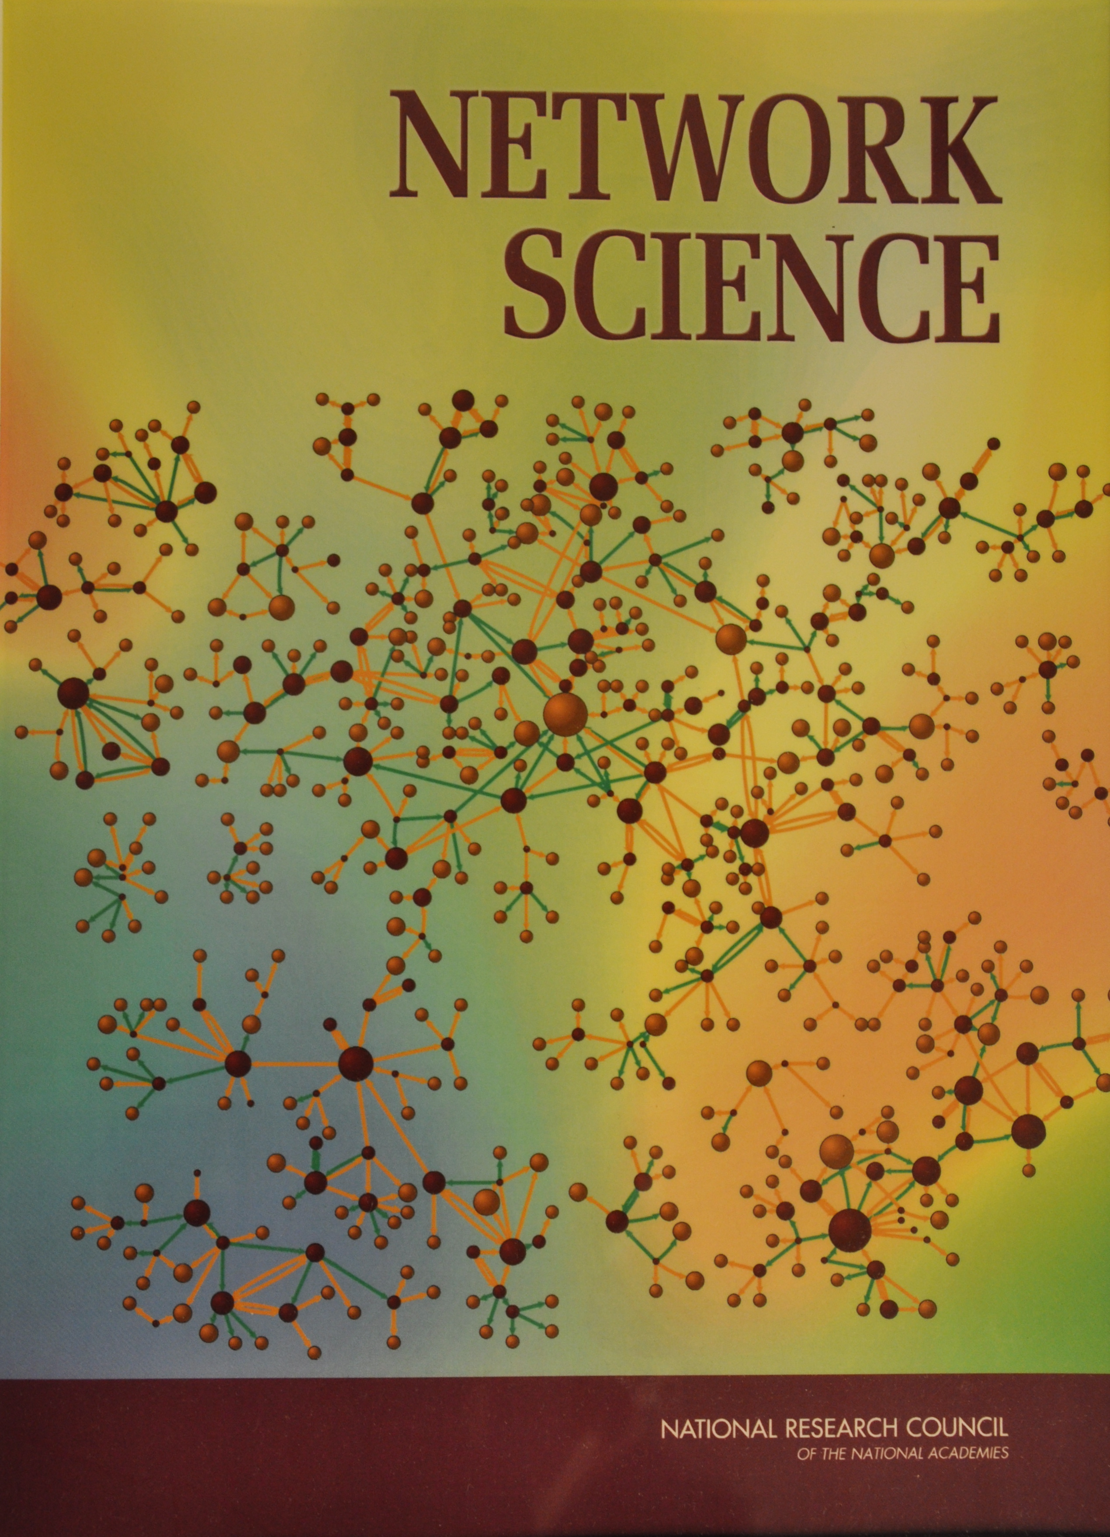

National Research Council
Network Science: Introduction
Notes:
Given this extraordinary response by the scientific com- munity, network science was examined by the Nation- al Research Council (NRC), the arm of the US National Academies in charge of offering policy recommendation to the US government. NRC has assembled two panels, resulting in two publications [31], defining the field of network science (Image 1.13). They not only document the emergence of a new research field, but highlight the field’s vital importance to national competitiveness and security. Following these reports, the National Science Foundation (NSF) in the US established a network science directorate and a series of network science centers were established by the Army Research Labs.

Slide 59
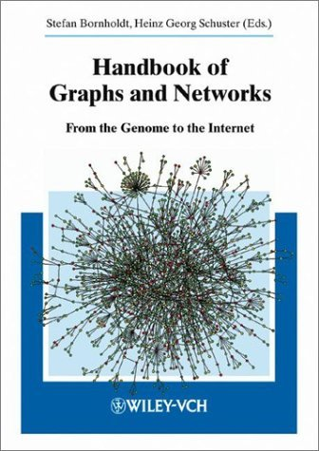


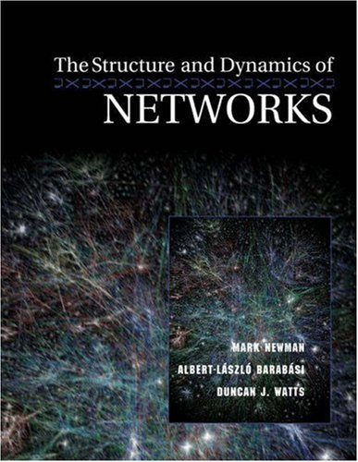

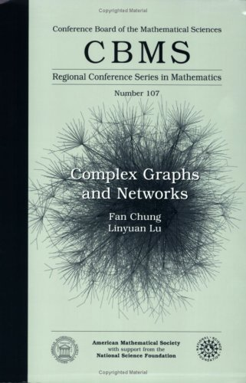
BOOKS
Handbook of Graphs and Networks: From the Genome to the Internet (Wiley-VCH, 2003).
S. N. Dorogovtsev and J. F. F. Mendes, Evolution of Networks: From Biological Nets to the Internet and WWW (Oxford University Press, 2003).
S. Goldsmith, W. D. Eggers, Governing by Network: The New Shape of the Public Sector (Brookings Institution Press, 2004).
P. Csermely, Weak Links: The Universal Key to the Stability of Networks and Complex Systems (The Frontiers Collection) (Springer, 2006), rst edn.
M. Newman, A.-L. Barabasi, D. J. Watts, The Structure and Dynamics of Networks: (Princeton Studies in Complexity) (Princeton
University Press, 2006), rst edn.
L. L. F. Chung, Complex Graphs and Networks (CBMS Regional Conference Series in Mathematics) (American Mathematical Society, 2006).
Network Science: Introduction
Notes:
I am a scientist, which means that I believe that natural phenomena can be CLICK
understood, quantified, predicted, and eventually
controlled.
No one would find any of these goals questionable.
What, however, if I now replace Natural Phenomena with humans. So lets read it together:
Humans can be understood, quantified, predicted, controlled.

Slide 60




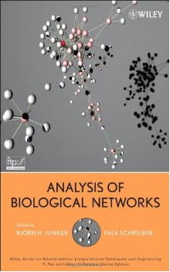

BOOKS
R. Pastor-Satorras, A. Vespignani, Evolution and Structure of the Internet: A Statistical Physics Approach (Cambridge University Press, 2007), rst edn.
F. Kopos, Biological Networks (Complex Systems and Interdisciplinary Science) (World Scientic Publishing Company, 2007), rst edn.
B. H. Junker, F. Schreiber, Analysis of Biological Networks (Wiley Series in Bioinformatics) (Wiley-Interscience, 2008).
T. G. Lewis, Network Science: Theory and Applications (Wiley, 2009).
E. Ben Naim, H. Frauenfelder, Z.Torotzai, Complex Networks (Lecture Notes in Physics) (Springer, 2010), rst edn.
M. O. Jackson, Social and Economic Networks (Princeton University Press, 2010).
Network Science: Introduction
Notes:
I am a scientist, which means that I believe that natural phenomena can be CLICK
understood, quantified, predicted, and eventually
controlled.
No one would find any of these goals questionable.
What, however, if I now replace Natural Phenomena with humans. So lets read it together:
Humans can be understood, quantified, predicted, controlled.

Slide 61



GENERAL AUDIENCE
Network Science: Introduction
Notes:
General Audience
The results of network science have excited the public as well. This was fueled partly by the success of several gener- al audience books, like Linked: The New Science of Networks by Albert-László Barabási, Nexus by Mark Buchanan, and Six Degrees by Duncan Watts, each being translated in many of languages. Newer books, like Connected by Nicholas Christakis and James Fowler, were also exceptionally successful (Image 1.15).

Slide 62

Thex
DOCUMENTARY
Network Science: Introduction
Notes:
An award-winning documentary, Connected, by Australian filmmaker Annamaria Talas, has brought the field to our TV screen, being broadcasted all over the world and winning several prestigious prizes (Image 1.14).
Networks have inspired artists as well, leading to a wide range of network science research inspired art project, and even an annual symposium series that brings together, on a yearly basis, artists and scientists [32]. Fueled by successful movies like The Social Network, and a series of novels and short stories, from science fiction to novels exploiting the network paradigm, today networks have permeated popular culture.

Slide 63
Section 9
SUMMARY
Network Science: Introduction
Notes:
Nowhere is the impact of network thinking more evident than in the scientific community. The most prominent scientific journals, from Nature and Science to Cell and PNAS, have devoted special issues, reviews, or editorials address- ing the impact of networks on various topics from biology to social sciences. During the past decade, each year several dozen international conferences, workshops, summer and winter schools have focused exclusively on network sci- ence. A successful network science meeting series, called NetSci, attracts the field’s practitioners since 2005. Several general-interest books, making the bestseller lists in many countries, have brought network science to the public. Most major universities offer network science courses, attracting a diverse student body.

Slide 64
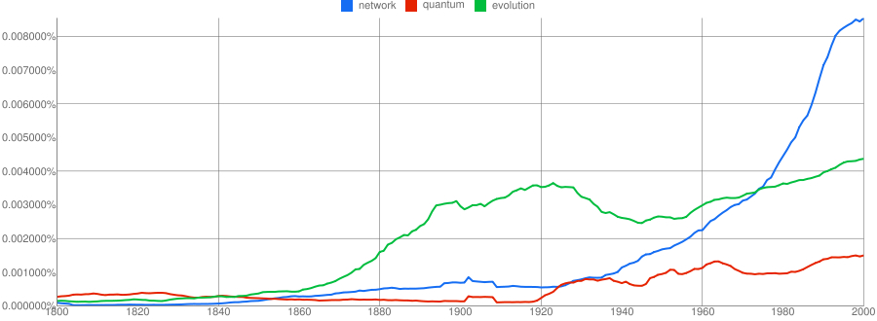
Thex
NGRAMS Networks Awareness
Network Science: Introduction
Notes:
While the emergence of the scientific interest in networks was rather sudden, the enthusiasm for the field was responding to the emergence of a wider social awareness of the importance of networks. This is illustrated in Image 1.16, where we show the usage frequency of the words that represent two important scientific revolutions of the past two centuries: evolution, capturing the most common term to refer to Darwin’s theory of evolution, and quantum, the most frequently used term when one refers to quantum mechanics. The use of evolution increases only after the 1859 publication of Darwin’s On the Origins of Species. The word quantum, first used in 1902, is virtually absent until the 1920s, when quantum mechanics gains prominence. The use of the word network has increased dramatically following the 1980s. While the word has many uses (as do evolution and quantum), its dramatic rise captures the extraordinary awareness of networks in the society at large. Indeed, evolution and quantum mechanics are just as important as core scientific fields, as they are as enabling platforms: the current revolution in genetics is built on evolutionary theory, and quantum mechanics offers a platform for a wide range of advances in contemporary science, from chemistry to wireless communications. In a similar fashion, network science is an enabling science, offering new tools and perspective for a wide range of scientific fields from social networking to drug design. Given the wide importance and impact of networks, we need to develop the tools to study and quantify them. The rest of this book is devoted to this worthy subject.
Image 1.16
The rise of networks.
The frequency of the use of the words evolution and quantum represents the major scientific advances of the 19th and 20th century, namely Dar- win’s theory of evolution and quantum mechanics. The plot indicates the exploding awareness of networks in the last decades of the 20th century, preparing a fertile ground for the emergence of network science. The plots were generated by using the ngram platform of Google: http://books. google.com/ngrams.

Slide 65
Thex
MOST IMPORTANT Networks Really Matter
If you were to understand the spread of diseases, can you do it without networks?
If you were to understand the WWW structure, searchability, etc, hopeless without invoking the Web’s topology.
If you want to understand human diseases, it is hopeless without considering the wiring diagram of the cell.
Network Science: Introduction

Slide 66
Class
CLASS INFORMATION
Network Science: Introduction
Notes:
Nowhere is the impact of network thinking more evident than in the scientific community. The most prominent scientific journals, from Nature and Science to Cell and PNAS, have devoted special issues, reviews, or editorials address- ing the impact of networks on various topics from biology to social sciences. During the past decade, each year several dozen international conferences, workshops, summer and winter schools have focused exclusively on network sci- ence. A successful network science meeting series, called NetSci, attracts the field’s practitioners since 2005. Several general-interest books, making the bestseller lists in many countries, have brought network science to the public. Most major universities offer network science courses, attracting a diverse student body.

Slide 67




Network Science an interactive textbook
barabasi.com/NetworkScienceBook/
facebook.com/NetworkScienceBook

Slide 68

barabasilab.com/NetworkScienceBook/ facebook.com/NetworkScienceBook

Slide 69
barabasilab.com/NetworkScienceBook/ facebook.com/NetworkScienceBook

Slide 70
Classes
Classes: 5:30-7:30pm
Always at the CCNR,
DANA building 57, 5th floor*
*unless a different location is announced (during classes, via email)

Slide 71
Course material and information
Webpage:
Syllabus, Agenda
Important links (visualization programs, wikis, glossary...)
Homework assignments
Slides
Our emails
The course outline
OpenRev platform: http://www.openrev.org/group/complex-networks
Updated book chapters
Google group mailing list for the class (and invite everyone)

Slide 72

Webpage
Slides as well as syllabus, agenda and assignments will be posted here

Slide 73

OpenRev
Update book chapters will be posted here before or soon after the lesson
Notes:
Show briefly how the website works

Slide 74
OpenRev
Important papers will be also posted here

Slide 75
OpenRev
You can write comments on the PDFs (will be seen by everyone)

Slide 76
Course material and information
http://barabasilab.neu.edu/courses/phys5116/
Important links (visualization programs, wikis, glossary...)
Homework assignments
Our email
Updates and messages
Syllabus
The course outline
Much much more
You can contact us at: r.sinatra@neu.edu, barabasi@gmail.com
We will also create a google mailing list for the class, and invite everyone.

Slide 77
Course overview
 |  | Monday |  | Wednesday |  | Friday | Comments | # lessons | Extra lessons
Sep. 1 - 5 | - | No classes (Labor day) | L. | Chapter 1: Introduction | L. | Chapter 2: Graph Theory |  | 3 | : +1
Sep. 7- 12 | L. | Chapter 3: Random Networks | L. | Chapter 4: The scale-free property | L. | Chapter 5: The Barabási-Albert model |  | 6 | : +2
Sep. 14 - 19 | L. | Chapter 6: Evolving Networks | L. | Chapter 6: Evolving Networks | L. | Preliminary Project Presentation |  | 9 | : +3
Sep. 21 - 26 | - | --- | - | --- |  |  |  | 9 | : +1
Sept. 28 - Oct. 3 | R. | Hands on: graph representation, binning | R. | Hands on: Gephi and Networkx |  |  | Hand-in assignments 1 | 11 | : +1
Oct. 6 - 10 | R. | Small-world networks | - | --- |  |  |  | 12 | 0
Oct. 13 - 17 | - | No classes (Columbus Day) | R. | Cycles and motifs |  |  | Hand-in assignments 2 | 13 | 0
Oct. 20 - 24 | L. | Chapter 9: Communities | L. | Chapter 7: Degree correlations |  |  |  | 15 | 0
Oct. 27 - 31 | L. | Chapter 8: Network robustness | L.-R. | Movie night |  |  |  | 16 | -1
Nov. 3 - 7 | L. | Chapter 10: Spreading phenomena |  | Guest speaker: Joerg Menche |  | Guest speaker (at noon): Michael Kearns | Hand-in assignments 3 | 19 | 0
Nov. 10 - 14 | L. | Weighted networks |  | Guest speaker: Yang-Yu Liu |  |  |  | 21 | 0
Nov. 17 - 21 | R. | Dynamics on networks (Random walks and page-rank) |  | Guest |  |  | Wikipedia write-up due | 23 | 0
Nov. 24 - 28 | R. | Open door class | - | No classes (Thanksgiving recess) |  |  |  | 24 | 0
Dec. 1 - 5 | L.-R. | TBA | L.-R. | Project Presentation (non-Network Science students) |  |  |  | 26 | 0
Dec. 8 - 12 | L.-R. | Project Presentation (PhD in Network Science) | Exam week

Slide 78
Course overview
 |  | Monday |  | Wednesday |  | Friday | Comments | # lessons | Extra lessons
Sep. 1 - 5 | - | No classes (Labor day) | L. | Chapter 1: Introduction | L. | Chapter 2: Graph Theory |  | 3 | : +1
Sep. 7- 12 | L. | Chapter 3: Random Networks | L. | Chapter 4: The scale-free property | L. | Chapter 5: The Barabási-Albert model |  | 6 | : +2
Sep. 14 - 19 | L. | Chapter 6: Evolving Networks | L. | Chapter 6: Evolving Networks | L. | Preliminary Project Presentation |  | 9 | : +3
Sep. 21 - 26 | - | --- (ECCS) | - | --- (ECCS) |  |  |  | 9 | : +1
Highlights:
15 min discussion on projects at the end of each class
Preliminary Project presentations on Friday Sep. 19th (No grading, only feedback)
5 min/max 5 slides. Print-out + email
Hand-out of first assignment (due on October 3rd)
No classes on the week Sep. 21-26

Slide 79
Course overview
Sept. 28 - Oct. 3 | R. | Hands on: graph representation, binning | R. | Hands on: Gephi and Networkx |  |  | Hand-in assignments 1 | 11 | : +1
Oct. 6 - 10 | R. | Small-world networks | - | --- |  |  |  | 12 | 0
Oct. 13 - 17 | - | No classes (Columbus Day) | R. | Cycles and motifs |  |  | Hand-in assignments 2 | 13 | 0
Highlights:
Bring a laptop for the class on September 30th
Hand-in assignment by Friday, October 3rd, 6pm
Hand-out of second assignment, hand-in by Friday, October 17th, 6pm
Bring the assignments here to the CCNR, and hand it to Roberta. If not in the office, slide it under the door of the room at the entrance

Slide 80
Course overview
Oct. 20 - 24 | L. | Chapter 9: Communities | L. | Chapter 7: Degree correlations |  |  |  | 15 | 0
Oct. 27 - 31 | L. | Chapter 8: Network robustness | L.-R. | Movie night |  |  |  | 16 | -1
Nov. 3 - 7 | L. | Chapter 10: Spreading phenomena |  | Guest speaker: Joerg Menche |  | Guest speaker (at noon): Michael Kearns | Hand-in assignments 3 | 19 | 0
Nov. 10 - 14 | L. | Weighted networks |  | Guest speaker: Yang-Yu Liu |  |  |  | 21 | 0
Highlights:
Movie Night: Connected, by Annamaria Talas. Probably later than 5.30pm (will be announced)
Hand-out of third assignment, hand-in by Friday, November 7th, 6pm
Lectures from guests on their research

Slide 81
Course overview
Nov. 17 - 21 | R. | Dynamics on networks (Random walks and page-rank) |  | Guest |  |  | Wikipedia write-up due | 23 | 0
Nov. 24 - 28 | R. | Open door class | - | No classes (Thanksgiving recess) |  |  |  | 24 | 0
Highlights:
Wikipedia write-up due by Friday, November 21st, 6pm. Email with link to wikipedia article, but also print-out and hand-in.
Open door class for questions or assistance about the final projects

Slide 82
Course overview
Dec. 1 - 5 | L.-R. | TBA | L.-R. | Project Presentation (non-Network Science students) |  |  |  | 26 | 0
Dec. 8 - 12 | L.-R. | Project Presentation (PhD in Network Science) | Exam week
Highlights:
Project presentations!
First day for all non-network science students
Second day for network science grad students
Send slides via email

Slide 83
Grading
#3 Written assignments (15% each, Total 45%)
(bring them to the CCNR and hand it directly to Roberta. If not in the office, slide it under the first door)
Wikipedia write-up (15%)
Projects (40%)

Slide 84
Wiki project recommendation
Select a keyword related to network science and check if there is a page for it in Wikipedia. “Related” is defined widely– you can talk about a technical measure related to networks (like degree distribution), a network-related phenomena (terrorist networks), the use of networks (network in finance), or anything else that you can convincingly relate to networks (Bacon number, Erdös number, Six degrees, actor network, networking).
If the page exists already, go to point 1, and start over. If it does not exist, plan to write a page on it. You are not expected to generate original results on your topic. The best is to identify 2-5 sources on the subject (research papers, books, etc.) and write a succinct, self-contained Wiki-style summary, with references, graphs, tables, images, photos, whichever is appropriate. You will need to observe Wikipedia’s copyright expectations for all visual material you add.
Upload your page on Wiki (actually, develop it there) and send us the link when you are done (but certainly by the due date). To be on the safe side, also print it out, write your name and hand it in. We will grade you how on understandable, pertinent and self-contained is the content, and your ability to link it to networks.
You will need to signup in wikipedia!
(anonymous editing not allowed)

Slide 85
Final project
The final project accounts for 40% of the final grade.
Collection and analysis of real network data
The project will be carried out in inter-program/year pairs (e.g. physics and bio). Undergrad students have to pair up with grad students.
Network science students carry on individual projects
Preliminary project presentation – September 19th. 5min/5 slides from each group
Final project presentation – December 8th (all non-network science students) and December 10th (Network science grad students). 15 min/15 slides from each group

Slide 86
Preliminary project
5 slides
Discuss:
What are your nodes and links
How will you collect the data
Expected size of the network (# nodes, # links)
What questions you plan to ask (they may change as we move
along with the class).
Why do we care about the network you plan to study.
Network Science: Evolving Network Models February 14, 2011

Slide 87
Final project guidelines
Measure: N(t), L(t) [t- time if you have a time dependent system); P(k) (degree distribution); <l> average path length; C (clustering coefficient), C_{rand,} C(k); Visualization/communities; P(w) if you have a weighted network; networ robustness (if appropriate); spreading (if appropriate).
It is not sufficient to measure things– you need to discuss the insights they offer:
What did you learn from each quantity you measured?
What was your expectation?
How do the results compare to your expectations?
Time frame will be strictly enforced. Approx 12min + 3 min questions;
No need to write a report—you will hand in the presentation (in pdf format).
Send us an email with the presentation named as LastName1_LastName2.pdf. E.g. barabasi_sinatra.pdf
Show an entry of the data source—just to have a sense of how the source looks like. On the slide, give your program/name.
Grading criteria:
Use of network tools (completeness/correctness);
Ability to extract information/insights from your data using the network tools;
Overall quality of the project/presentation.

